Slide 1
Quarterly Information Session Licensing 101

Slide 2
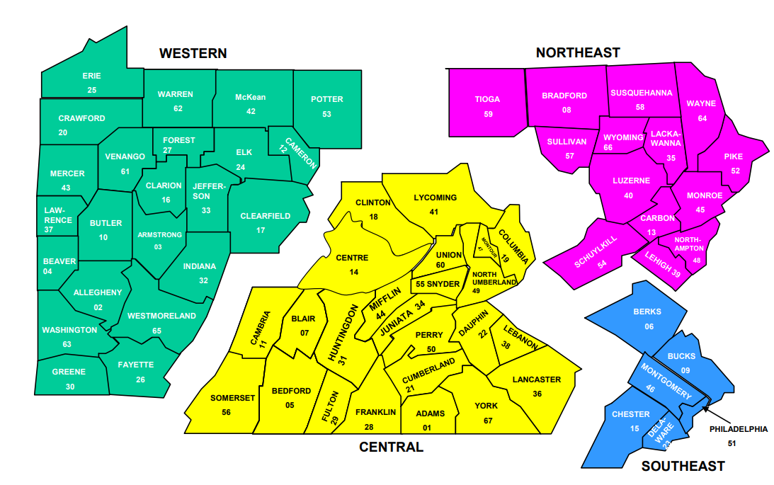
Bureau of Children and Family Services, OCYF
The Bureau of Children and Family Services’ four regional offices provide regulatory oversight for the following services:
Public county children and youth agencies (67)
Private county children and youth agencies (606)
Child Residential and Day Treatment Facilities (588)

Slide 3
Regional Directors
Central Region
Gabrielle Williams: gawilliams@pa.gov
Northeast Region
Brian Waugh: bwaugh@pa.gov
Southeast Region
Andrea Clarke: aclarke@pa.gov
Western Region
Amber Kalp: akalp@pa.gov
Bureau Director
- Caitlin Robinson: cairobinso@pa.gov

Slide 4
General Overview of Licensing Process
For the most part, all DHS licensing offices follow the following licensing process/procedures
Prior to issuing an initial license, the application packet must be approved, and an onsite inspection must occur
All licensees are inspected on an annual basis
Areas of non-compliance are documented on a Licensing Inspection Summary (LIS)
In response to receiving an LIS, the licensee must submit the plan of correction (POC). The POC must be approved by the Department
The licensing office will then verify that the POC was properly implemented

Slide 5
PREPARING FOR ANNUAL LICENSING VISITS
A point person will be assigned to your annual review. It is important to have consistent communication with this person.
You can request the checklist ahead of time which outlines the items that the regional staff will be looking for during the review.
The list of cases for review will be provided prior to the start of your annual review.
Make sure all files are readily available for the regional staff and you communicate ahead of time any concerns.
If your review involves your computer system, it is best to check those ahead of time to help ensure no issues on the day(s) of licensing

Slide 6
COUNTY AGENCY SAMPLE SIZE
10% or no more than 10 cases for each life of case area to be reviewed during licensure All life of case areas (screen-outs*; Intake: CPS; Intake: GPS; In-home; Placement; and Adoption)
Note Cases should be inclusive of a sampling of the following:
One of the in-home or placement cases reviewed should be a shared responsibility case.
Sample size should include youth in care or discharged from care after the age of 16 and one resumption of jurisdiction case.
At least 1 case with primary goal of APPLA and 1 case with the concurrent goal of APPLA
At least 1 case of Plans of Safe care if applicable
At least 1 case of IL
For counties in which the licensing inspection follows the QSR, the cases pulled as part of the QSR sample will comprise part of sample for the annual inspection. Additional cases may need to be pulled to meet the licensure sampling criteria.
In addition to the above, there will be 2 ICPC cases reviewed:
One ICPC case will be Pennsylvania as the Sending State
One ICPC case will be Pennsylvania as the Receiving State
County Operated Foster Homes (including Kinship)-
All new homes reviewed during the Period Under Review
If there are more than 30 homes, the following sample will be used:
31-60 homes: 50%
60-90 homes: 30%
Over 90 homes: 25%
Tenured or older than one licensing year = 10% or more than 10
Foster Home Visits
The percentage of all approved foster/resource homes on the date the list is generated for licensing will be used to determine the visit sample.
The sample size for the visit will be 10% of the total approved homes with no less than 2 homes being visited and no more than 4.
The resource homes visited should consist of at least one (1) newly approved home and one (1) tenured home, and a mixture of foster/resource home types (kinship, traditional foster care).
When at all possible, the resource homes visits should be homes that were not visited in the previous inspection year.
Personnel Records – All new employee personnel files hired during the Period Under Review & training records for all staff

Slide 7
3800 PROVIDER SAMPLE SIZE
Licensing staff will review 10% of children served during the period under review per license to include a comprehensive sample of the children served.
Licensing staff will review additional files as necessary for a variety of other factors.
For child records, select a sample of children for whom restrictive procedures are used, children with complex medical conditions, a mix of dependent and delinquent children, children served in different programs/living units within the facility, children who were recently admitted, and children who were recently transferred or discharged. Regional licensing staff will request this information prior to the inspection. The requested information will accompany the Annual Licensing Inspection letter that will be sent 30 days prior to the inspection.
For staff records, regional licensing staff will review all staff files.
All new staff, during the licensing year, will be reviewed. This includes employees that may no longer be employed.
Licensing staff will review all tenured staff files for clearances, training, and health statements.
In addition, licensing staff will review qualifications and updated job descriptions for promoted staff during the licensing year.
Regional licensing staff will also request additional information approximately 30 days prior to the onsite inspection. The includes, but is not limited to current description of services, organizational chart, current waivers, insurance coverage, self-attestation form (Prison Rape Elimination Act), changes in personnel policies or service policies, listing of consultants, notification to local fire officials (if applicable), fire safety permit, fire drill logs, inoperable fire alarm policy, emergency medical plan, private water testing (if applicable), elevator and sewage approval (if applicable), furnace/ boiler inspections, policy manual, copy of child’s rights, 2 weeks of staff schedules, staff training plan, trainer certifications, staff listing with classification (by department / living unit / license), personnel records, documentation of training, grievances, restrictive procedure logs, reportable and recordable incidents, and where files are stored.

Slide 8
Inspection Summaries
DHS Licensing Timeframe Standards:
DHS issues licensing inspection Summary (15 business days)
Provider/County submits plan of correction (10 calendar days)
DHS responds (10 business days)
If not approved, provider/County submits updated plan (5 Calendar days)
If plan not acceptable, DHS issues specific conditions of approval of plan (5 business days)

Slide 9
DHS Bulletin: Timeframes for Issuance of Licensing Inspection Summary, Plan of Correction, and Verification
Issued: July 15, 2019

Slide 10
DHS Bulletin
1. DHS will attempt to commence all annual license inspections at least three months prior to the expiration/renewal date of the current License/Certificate of Compliance (COC). DHS may conduct complaint investigations and monitoring inspections at any time.
2. If DHS finds any violations of applicable statutes or regulations (licensing violations) during the on-site inspection, then DHS will issue a Licensing Inspection Summary (LIS). DHS will attempt to issue the LIS within 15 business days of the date of the exit conference.
3. In response to the LIS, the licensee shall return an acceptable plan of correction (POC) to the program office. The licensee should return the POC to DHS no later than 10 calendar days after DHS sent the LIS to the licensee. Based upon the violations, DHS may request the POC be submitted earlier than 10 calendar days after the program office sent the LIS to the licensee.

Slide 11
DHS Bulletin
4. An acceptable POC must include, at a minimum, concrete and measurable corrective actions to address each specific licensing violation, including any measures or systemic changes to ensure that the licensing violation will not reoccur.
5. DHS either accepts or does not accept the POC. DHS will attempt to accept or not to accept the POC within 10 business days of DHS’s receipt of the POC.
6. If DHS does not accept the POC, then the licensee shall submit a second, revised POC. The licensee should submit the second, revised POC within five business days (or less if DHS determines it necessary) of the date of the notice from DHS that the first POC was unacceptable.
7. Upon receipt of the second, revised POC, DHS either accepts or does not accept the POC. DHS will attempt to accept or not accept the second, revised POC within 5 business days of DHS’s receipt of the second, revised POC.

Slide 12
DHS Bulletin Cont.
8. If DHS does not accept the second, revised POC, then DHS may direct the POC, or may take further licensing action, which could include revocation or refusal to renew the COC, or issuance of a provisional COC. DHS will attempt to notify the licensee within 10 business days from the date the second plan of correction was determined not acceptable.
9. Upon acceptance of the POC, DHS will send a written notification to the licensee that the POC is acceptable. DHS’s acceptance of a POC only serves as DHS’s acknowledgement of the licensee’s willingness to adequately and timely correct the licensing violations. Acceptance of a POC did not and does not absolve the licensee of the obligation to achieve and maintain compliance, nor does it confirm that the licensee is compliant with licensing requirements. This notification will be posted to the web.
10. DHS verifies compliance by an onsite reinspection or by reviewing documentation that was submitted by the licensee and that conclusively demonstrates the POC was implemented, compliance was achieved and is being maintained. Documentation may include written policies, sign-in sheets for staff training attendance, resident assessments and support plans, maintenance logs, and other internal documents. Photographs and videos may also serve to demonstrate corrective action with repairs or improvements to the physical site and grounds.

Slide 13
DHS Bulletin Cont.
11. The timeframe for verification of compliance should be based upon how the regulatory violations may impact the health and safety to individuals. DHS will attempt to re-inspect those violations that pertain to serious health and safety issues within five business days after the implementation date of the POC for that specific violation. For all other compliance issues, DHS will attempt to re-inspect or review documents within 30 calendar days after the last implementation date specified in the POC. By way of further explanation on the 30-day timeframe, if a POC contains multiple items and plans responsive to a LIS, then the latest date should be used when determining the timeframe for completing the re-inspection. Nothing in this guidance precludes DHS licensing staff from conducting on-site monitoring visits before the specific implementation date of the POC or any item within the POC.
12. If, upon reinspection or document review, DHS finds that the licensee has achieved and is maintaining compliance, then DHS will notify the licensee in writing and issue a new annual COC. The program office will also update, accordingly, any documents posted to the web to indicate that the plan of correction has been implemented and the licensee has achieved compliance.
13. If DHS finds that a POC has not been fully implemented or the licensee has not achieved and maintained compliance with any licensing requirements, then the program office should issue a provisional COC unless there is an extraordinary circumstance.
14. Nothing in this guidance limits DHS in any way from taking other licensing action, as DHS determines appropriate, pursuant to applicable law.

Slide 14
Inspection Summaries Content
Quantification of Citations:
The introductory paragraph identifies the number of case records pulled for each service type: In-Home, Placement, Adoption, CPS Investigations, GPS Investigations, Screen-Outs, Personnel, Resource Homes
Any citations noted will identify the number of citations out of the population of records pulled:
Example: 1 out of 10 In-Home Records, 3 out of 26 Resource Family Records
Citations are not to be duplicated, but you may see citations separated out by service type.
Example: Safety Assessment citations of the same nature may appear twice (GPS and then in CPS)

Slide 15
Inspection Summaries Content
Repeat Violations:
Efforts are made to ensure cases pulled throughout the year are not pulled during the annual inspection so as to avoid duplication of citations.
Regulatory violations from previous year will be identified.
If violations noted are repeat, either from prior year or recent investigations, the citation will reference an existing POC and actions needed, i.e. continued implementation, reviewing and amending etc.
LIS should note if the cites are pre or post the current POC in existence.
All statutory or regulatory violations noted are recorded on the LIS.

Slide 16
Inspection Summaries Content
At any time during an annual inspection, if the county recognizes a case that has previously been reviewed during the period under review, please notify the regional lead.
Exit conferences at the end of the annual inspection should note findings based off the Clarification Request Form.
Regional office staff will also identify any concerns and/or potential citations with the county at the end of a complaint, CPS or NF/F record review.

Slide 17
Plan of Correction
An effective plan of correction should include:
Realistic timeframes
Sustainable over time
Defined positions that will carry out the plan
Defined checks and balances to ensure compliance
If determined to be a more systemic concern, the plan should address more holistically and not necessarily those individual cases.
If you are going to need additional time to complete an extension needs to be granted from the region.
Web based training: services.dpw.state.pa.us/DPC-Provider-Training/index.html

Slide 18
LICENSING ACTIONS
A provisional license may be issued when the Department determines that a licensee is in substantial but not complete compliance with applicable laws and regulations.
The Department can set the timeframe for a provisional license but it cannot exceed 6 months
A licensee continues to operate under a provisional license, regardless of whether they appeal or not. Once the licensee achieves full compliance, a regular (full) license is issued.
The Department can issue up to 4 provisional licenses. After the fourth provisional license, if the licensee has not earned a full license, then further licensing actions will be taken up to and including revocation.
If a situation at a facility constitutes an “emergency,” as defined in the regulations, the Department can issue an emergency order to remove participants from the facility
Notes:
Decision for a provisional license does not sit with the regional office.

Slide 19
TECHNICAL ASSISTANCE
If technical assistance is being provided on a case, then the regions will not issue citations.
A County or agency can request training be provided in any areas where additional support might be needed.
The regions can help design a technical assistance plan that will identify areas of improvements and strengths.
A County or an agency can request technical assistance at anytime.
Reach out to your assigned Rep. If you do not know who is assigned, then you can reach out to the appropriate regional director for further assistance.
The Regions can help connect with other resources
A technical assistance plan will be required if an agency/County is placed on a Provisional which will also include increased monitoring.

Slide 20
MONITORING VISITS
During monitoring visits
Bring questions/concerns to your rep.
Rep. will often want to speak with staff to check-in how things are going.
Review progress on any current technical assistance plans
May review some cases
Can review newly released bulletins
Can also provide staff trainings during this time
For 3800 additionally the following should occur:
A walkthrough of the facility
Interview youth placed

Slide 21
QUESTIONS?
QUESTIONS?

