Slide 1
What is the Older Child Matching Initiative (OCMI)
and
Why Should I Consider
Referring My Youth For This
Free Service?
Joyce Riche
Karen Knodel
Diakon Adoption & Foster Care
Kelly Myers
Family Design Resources

Slide 2
What is the SWAN OCMI Grant?
State-funded grant
Focuses on matching older youth with adoptive families
Involves intensive recruitment
Free service
Created in 2008

Slide 3
What are the Requirements?
10 years of age or older.
Sibling groups- 1 youth must be 10 years of age or older.
Have a primary goal of adoption (county established or court ordered).
Be legally free unless the court that determines dependency will not terminate parental rights until an adoptive resource has been identified.
Be eligible for active PAE registration.
Be allowed to use identifying photos for recruitment purposes.

Slide 4
OCMI Partners
Diakon Adoption & Foster Care
SE and NE Pennsylvania- Helene Kosciolek
NE Pennsylvania- Marian Kolcun
Central Pennsylvania- Katie Juliana
Central Pennsylvania-Amanda Harlacher
Partner Agencies
Bethanna, SE Pennsylvania-To Be Hired
Project STAR at The Children’s Institute, SW Pennsylvania- Russ McCurdy
Family Pathways, West and NW Pennsylvania- Nic Landon and Karly Vogt

Slide 5
Older Child Matching Initiative (OCMI) Map
Erie
Karly Vogt Family Pathways
Warren
McKean
Potter
Tioga
Bradford
Susquehanna
Crawford
Wayne
Forest
Cameron
Sullivan
Wyoming
Venango
Elk
Lackawanna
Pike
Mercer
Clinton
Lycoming
Marian Kolcun Diakon
Clarion
Jefferson
Luzerne
Lawrence
Montour
Monroe
Butler
Clearfield
Union
Columbia
Armstrong
Centre
Carbon
Nic Landon Family Pathways
Snyder
Northumberland
Northampton
Beaver
Indiana
Mifflin
Schuylkill
Juniata
Lehigh
Allegheny
Cambria
Amanda Harlacher Diakon
Dauphin
Helene Kosciolek Diakon
Russ McCurdy Project STAR
Blair
Perry
Lebanon
Berks
Bucks
Westmoreland
Huntingdon
Montgomery
Washington
Katie Juliana
Diakon
Cumberland
Lancaster
Bethanna
Somerset
Bedford
Fulton
Franklin
York
Chester
Delaware
Philadelphia
Greene
Fayette
Adams
Karen Knodel: knodelk@diakon.org; 610.682.1527
Amanda Harlacher: harlachera@kiakon.org; 717.795.0317
Katie Juliana: julianak@diakon.org; 717.795.0479
Marian Kolcun: kolcunm@diakon.org; 570.351.9290
Helene Kosciolek: kosciolekh@diakon.org; 610.682.1564
Nic Landon: nlandon@familypathways.net; 724.284.9440
Russ McCurdy: rum@the-institute.org; 412.244.3083
Karly Vogt: kvogt@familypathways.net; 814.807.2578
Notes:
5

Slide 6
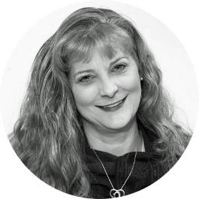
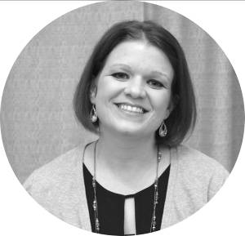
OCMI Recruiters
Karen Knodel
Katie Juliana
Marian Kolcun
Helene Kosciolek
Russ McCurdy
Nic Landon
Karly Vogt

Slide 7
Erie
Warren
McKean
Potter
Tioga
Bradford
Susquehanna
Crawford
Wayne
Forest
Cameron
Sullivan
Wyoming
Venango
Elk
Lackawanna
Pike
Mercer
Clinton
Lycoming
Clarion
Jefferson
Luzerne
Lawrence
Montour
Monroe
Butler
Clearfield
Union
Columbia
Armstrong
Centre
Carbon
Snyder
Northumberland
Northampton
Beaver
Indiana
Mifflin
Schuylkill
Juniata
Lehigh
Allegheny
Cambria
Dauphin
Blair
Perry
Lebanon
Berks
Bucks
Westmoreland
Huntingdon
Montgomery
Washington
Cumberland
Lancaster
Somerset
Bedford
Fulton
Franklin
York
Chester
Delaware
Philadelphia
Greene
Fayette
Adams
64 Counties and Growing!
Notes:
7

Slide 8
What Services are Provided?
Recruiters complete a case record review
Recruiters complete PAE registration
Recruiters meet youth monthly
Recruiters meet with treatment team and participate in team meetings
Recruiters read family profiles and submit possible families to county
Recruiters participate in matching, selection, and placement
Recruiters perform family finding if requested

Slide 9
Youth-Driven Recruitment Activities
Matching Moments
Matching Events
Flyers, Power Point Presentations
Older Youth Match Parties
Waiting Child TV Segments
Val’s Kids, A Little Love, Waiting Child, Wednesday’s Child, Hearts Without Homes, Adopt Lehigh Valley Kids,
Heart Gallery and/or SWAN Photographers
Radio
Waiting Children at a Glance
Diakon’s Website and Facebook Page

Slide 11
Media campaign featuring OCMI youth- 2013, 2014, and 2017
Television and radio
Print
Documentary
Top Flight Media won a Mid Atlantic Emmy Award for the 2013 #MeetTheKids documentary.
6 youth from the 2013 campaign have been finalized; 2 others achieved another type of permanency.
3 youth from the 2014 campaign have achieved permanency
1 youth from the 2017 campaign has been finalized; several other have been placed and are waiting finalization.

Slide 12
OCMI versus Traditional CSR
OCMI youth must be 10 years old.
OCMI youth must meet eligibility requirements from earlier slide.
OCMI youth must be eligible for PAE registration.
Youth-driven recruitment.
Free service.
Continued involvement through finalization
CSR referrals can be any age child.
CSR referrals can be for children with any goal.
CSR referrals should be PAE registered.
CSR can be youth-driven.
Uses SWAN dollars .
Services typically end prior to placement of child.

Slide 13
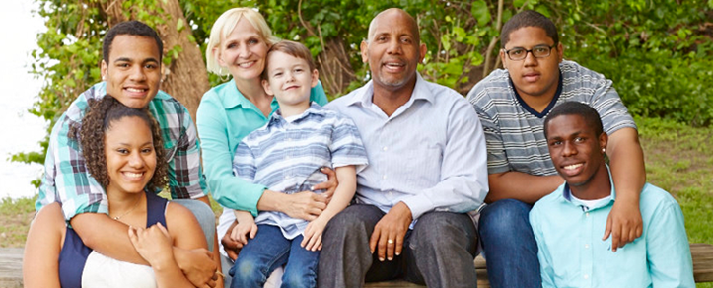
Statistics
2008-2009
7/1/08 to 6/30/08
2017-2018
7/1/17 to 2/28/18
(66.6% of the year)
Matches: 53
Placements: 18
Finalizations: 3
Matches: 25
Placements: 17
Finalizations: 12

Slide 14
Referral Process
Type of service you are requesting
Non-relative recruitment, family finding, or both
Demographic information
Goals
Brief summary of youth’s current circumstances
SWAN services as well as other services youth is receiving
Verification that identifying photographs can be used for recruitment purposes
Referrals NOW made through the SWAN portal

Slide 15
Making an OCMI referral on the SWAN portal
Search for the Child
Click on their name to get to the Child Summary Page
Click on the OCMI referral button
Verify the demographic and sibling information
Select the county contact for OCMI referral
Verify the status information and click submit

Slide 16
Next Steps
Signed Memorandum of Understanding (MOU)
Contact person to receive monthly OCMI reports
Make a referral at anytime
First come, first serve!
Waiting List

Slide 17
Questions?
For future questions:
Karen Knodel, Manager of Permanency and Grants
Diakon Adoption & Foster Care
1 South Home Ave.
Topton, PA 19562
610-682-1527
knodelk@diakon.org

