Slide 1
205: Ethical Engagement and Service for Children and Families with Hearing Loss and/or Vision Loss

Slide 2
Learning Objectives
Participants will be able to:
Name key legislative mandates regarding the rights of individuals with hearing loss and/or vision loss
Identify strategies and resources to overcome barriers to providing services to individuals with hearing loss and/or vision loss
Identify accommodations that can be used to engage and serve individuals with hearing loss and/or vision loss
Recognize the ethical obligations in providing services to individuals with hearing loss and/or vision loss

Slide 3
Competencies
205-2: The Child Welfare Professional understands legal issues, which affect child welfare practice, and knows how to implement legal requirements into practice. This includes confidentiality, caseworker liability, reasonable efforts, and other requirements.
102-11: The Child Welfare Professional can coordinate the delivery of services to meet identified needs through case management, referral to community resources, advocacy, and directly providing supportive or rehabilitative services

Slide 4
Competencies, continued
108-1: The Child Welfare Professional understands the concept of cultural competence; knows how one’s own culture affects behavior and values; and knows how cultural and ethnic differences may affect the delivery of child welfare services.
304-6: The Child Welfare Professional is aware of the negative stereotypical attitudes and misconceptions regarding developmental disabilities and knows how these stereotypes can interfere with the provision of services to clients with disabilities.

Slide 5
Agenda
Welcome and Introductions
Key Legislative Mandates
Cultural Considerations
Barriers
Accommodations
Resources
Summary and Evaluation

Slide 6
Welcome and Introductions
Trainer Introduction
Name Tents
Training Room Guidelines
Agenda/Idea Catcher

Slide 7
Key Legislative Mandates
OCYF Letter
Federal Legislation
State Legislation

Slide 8

OCYF Letter

Slide 9
Ethical Obligation
It is an ethical obligation for child welfare professionals to
“…know and comply with local, state, and federal legislations, regulations, and policies.”
(National Association of Social Workers Standards for Social Work Practice in Child Welfare, 2013, p. 12)

Slide 10
NASW Code of Ethics
1.03 Informed Consent
  b. “In instances when clients are not literate or have difficulty understanding the primary language used in the practice setting, social workers should take steps to ensure clients’ comprehension. This may include providing clients with a detailed verbal explanation or arranging for a qualified interpreter or translator whenever possible.”

Slide 11
NASW Code of Ethics cont’d.
1.05 Cultural Competence and Social Diversity
a. “Social workers should understand culture and its function in human behavior and society, recognizing the strengths that exist in all cultures.”
b. “Social workers should have a knowledge base of their clients’ cultures and be able to demonstrate competence in the provision of services that are sensitive to clients’ cultures and to differences among people and cultural groups.”

Slide 12
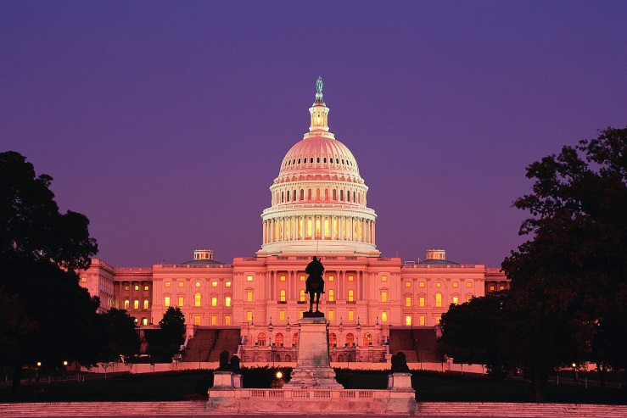
Federal Legislation:
Section 504 of the Rehabilitation Act of 1973
Guarantees certain rights to people with disabilities
Prohibits discrimination based on a disability
Affects employers and organizations that receive federal funding

Slide 13

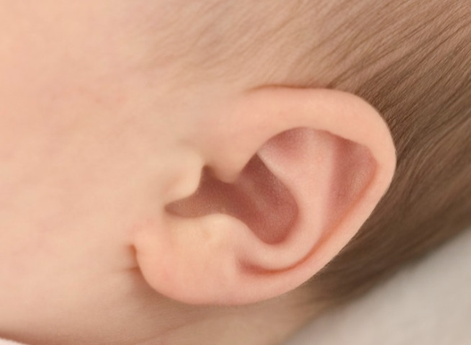
  Section 504: Definition of ‘Disability’
A disability is a physical or mental impairment which substantially limits one or more major life activities
Seeing and hearing are included in the definition of major life activities
Notes:
Audio:
Section 504 protects qualified individuals with disabilities. Under this law, a disability is defined as a physical or mental impairment which substantially limits one or more major life activities.
Seeing, hearing, and speaking are listed among major life activities as defined by Section 504. The list also includes caring for one's self, walking, breathing, working, performing manual tasks, and learning.
Tech;
http://www.bigstockphoto.com/image-1010918/stock-photo-autumn-woman
Alt.tag: young blind woman with cane sitting on park bench in the sun and smiling.

Slide 14
Federal Legislation:
Civil Rights Restoration Act
Passed in 1988
Restored protections mandated in Section 504 of the Rehabilitation Act
Reinforced implementation of other civil rights legislation as well

Slide 15

Federal Legislation:
Title II of the Americans with Disabilities Act (ADA)
Covers ‘public entities’:
State and local government
Title II covers all activities of public entities, whether or not they receive Federal funds

Slide 16
Key Provisions
Prohibits discrimination on the basis of disability in all activities of State and local governments, whether or not they receive federal financial assistance
Requires equal access to programs for individuals with a disability
Requires equally effective communication to be provided for individuals with a disability
Establishes a complaint mechanism for resolving allegations of discrimination
Notes:
Audio:
Title II of the Americans with Disabilities Act prohibits discrimination on the basis of disability by public entities. Title II of the ADA also adopts the requirements that were established under section 504 of the Rehabilitation Act of 1973 for making services and programs accessible to individuals with disabilities, and for providing equally effective communications.
Title II incorporated these and other key provisions, and eliminated one significant limitation of Section 504.
Section 504 established the prohibition of discrimination only in federally assisted programs.
Title II extends this prohibition of discrimination on the basis of disability to all activities of State and local governments, including those that do not receive Federal financial assistance.

Slide 17

State Legislation: Providing Interpreters
General Assembly of Pennsylvania Act 172 of 2006
PA Act 57 of 2004
Requires use of state certified interpreters

Slide 18

Beyond Compliance:
Pennsylvania Best Practice
The Pennsylvania Child Welfare Practice Model
Values
Skills
Principles

Slide 19
Idea Catcher!

Slide 20
Cultural Considerations
Cultural Competence
Deaf and Hard of Hearing:
  Myth vs. Fact
  Terms and Definitions
  Deaf Culture
Blindness and Low Vision:
  Myth vs. Fact
  Terms and Definitions
  Community and Discrimination

Slide 21


Cultural Competence Continuum

Slide 22

Meeting
http://www.youtube.com/watch?v=sWZFMG3df_A

Slide 23

Quiz!
Myth
or
Fact?

Slide 24
Deaf Culture
Prolonged eye contact
Face-to-face communication
Directness
Openness
Touching
Pride
Humor

Slide 25
Children of Deaf Adults (CODAs)
Hearing or Deaf?
Nearly 90% of children born to two deaf parents have normal hearing.

Slide 26
Quiz!
Myth
or
Fact?

Slide 27
Blind Community: Common Experience

Slide 28
Family Interaction
Activity Directions
Read the scenario together.
Act out the scenario.
Record observations on Observation Sheet
Talk together about the experience, using the five discussion questions on the back of the Observation Sheet.
Prepare to share insights with the rest of the class.

Slide 29
Idea Catcher!

Slide 30
Barriers
Communication
Cuelessness
Transportation
Fear
Identifying Resources

Slide 31
Communication
Speaker factors
Listener factors
Environmental factors

Slide 32
I’m Cueless, Not Clueless
Cuelessness:
Inability of an individual with vision loss to perceive nonverbal cues

Slide 33
Transportation

Slide 34
Fear
Stigmatization
Judgment
Disapproval
Mistrust

Slide 35
Identifying Resources

Slide 36
Idea Catcher!

Slide 37
Accommodations
Scenario
Hearing Loss
Vision Loss
Idea Catcher

Slide 38
Scenario
You have been assigned a new case in which both parents are deaf. You are preparing for your first home visit with the family.
    What steps will you take in preparation for the home visit?
    What accommodations will you arrange for?

Slide 39
Accommodations for Hearing Loss
Captioning
Communication Access Real-time Translation (CART)
Video
Mobile phones
Assistive Listening Devices (ALD), ex: FM system
Sign language interpreters

Slide 40
Accommodations for Vision Loss
Computer programs, i.e. screen review software, translation software
Smart phone apps
Video magnifiers
Braille technology
Optical Character Recognition System (OCR)

Slide 41
Idea Catcher!

Slide 42
Resources
Pennsylvania State Offices

Slide 43
Resources
Pennsylvania Office for the Deaf and Hard of Hearing (ODHH): http://www.portal.state.pa.us/portal/server.pt/community/office_for_the_deaf___hard_of_hearing/10371
The Pennsylvania Bureau of Blindness and Visual Services (BBVS): http://www.dli.state.pa.us/portal/server.pt/community/blindness_and_visual_services/10367
PA Initiative on Assistive Technology (PIAT): http://disabilities.temple.edu/programs/assistive/piat/

Slide 44

Questions?

Slide 45
Summary and Evaluation
Your feedback helps PACWRC to continuously improve the quality and relevance of our courses.

