Slide 1
Strengthening Our Practice: Strengthening Our Families
2013 Family Center Annual Event  PACWRC  April 17, 2013
Karen Shanoski
Stephanie Maldonado
Jeanne Schott

Slide 2
Introduction
Learning Objectives
Agenda

Slide 3
Learning Objectives
By the end of this workshop , the participant will be able to:
Recognize the role of ‘Strengthening Families’ and the Protective Factors Framework
Recognize the role of the Pennsylvania Child Welfare Practice Model in fulfilling our mission
Identify connections and commonalities between Pennsylvania’s Child Welfare Practice Model and the Strengthening Families Protective Factors Framework
Notes:
The achievement of positive outcomes for Pennsylvania’s children, youth and families is an overarching goal that those serving families can easily agree upon. While the approaches are as varied and unique as the families served, there are many similarities to the mission of our work. This workshop will explore the connections and commonalities between Pennsylvania’s Child Welfare Practice Model and the Strengthening Families Protective Factors Framework.

Slide 4
Workshop Agenda
Introduction
Strengthening Families
The Protective Factors Framework
The Pennsylvania Child Welfare Practice Model

Slide 5
Strengthening Families

Slide 6
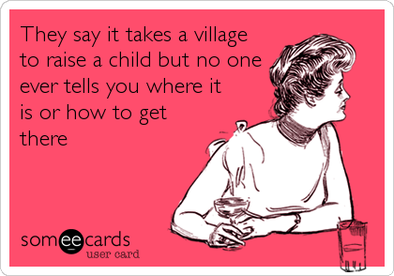
Our goal: To help everyone understand how we are all fellow villagers working together as a team to help raise the children and youth of Pennsylvania.

Slide 7
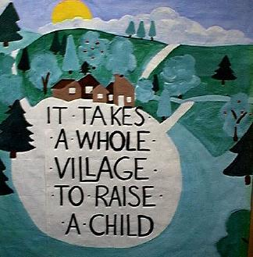
Why does it take a village?
Strengthening families and preventing child abuse requires a shared commitment of individuals and organizations in every community.

Slide 8

Juggling the demands of work, home, and other responsibilities leaves many parents feeling like they do not have nearly enough time with their children. Even small acts of kindness and can make a big difference to a parent who is struggling to achieve all their goals.
So where do we begin? How do we help?
Notes:
Café Talk Activity
Parent Modules
Center on the Social and Emotional Foundations of Early Learning
http://csefel.vanderbilt.edu/resources/training_parent.html

Slide 9

Parents say they want to…
Know their children feel loved
Be responsive to child
Have connections
Meet basic needs
Show courage

Slide 10
What is ‘Strengthening Families’ all about?
“Strengthening Families” began as an approach to child abuse prevention
Research based
Focus on strengths, not risks
For all families
Start where families already go
Build on and connect existing programs and strategies, not invent new ones

Slide 11
‘Strengthening Families’ began with a focus on children 0-5
Highest rates of abuse and neglect for children under 4
The brain’s primary architecture is developing in years 0-5
Adverse experiences at an early age create lifelong risk

Slide 12

A Common Approach
‘Strengthening Families’ quickly moved beyond child abuse prevention for young children and was adapted for a wide variety of programs, integrating a common approach to the needs of families into many kinds of services.

Slide 13
The Protective Factors Framework

Slide 14
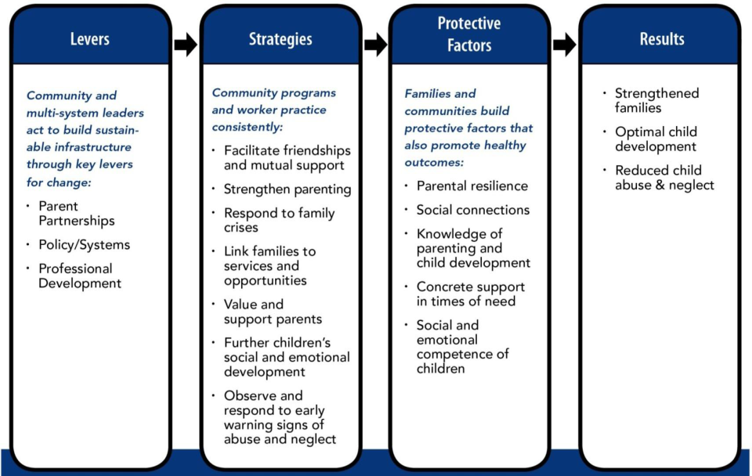
The Protective Factors:

Slide 15

Social and Emotional Competence
“My child feels loved, a sense of belonging and can get along with others.”

Slide 16
How Programs Can Promote
Social-Emotional Development:
Help parents to see positives in their children, despite challenging behaviors
Include parents
Teach social and emotional skills
Share strategies….

Slide 17

Adequate Knowledge of Parenting and Child Development
“I stay curious and am responsive to what my child needs.”

Slide 18
How Programs Enhance Parents’ Knowledge:
Help parents understand child development
Be a role model for parents
Form partnerships with parent education organizations
Share strategies……

Slide 19

An Array of Social Connections
“I have people who know me– friends. And at least one person who supports my parenting.”

Slide 20
How Programs Help Parents Develop Social Connections:
Informal space for parents to gather
Blend social and parent education activities
Organize activities that bring parents together
Reach out and connect isolated parents
Share strategies….

Slide 21

Concrete Support in Times of Need
“My family can access basic needs when they need it.”

Slide 22
How Programs Help Families Access Concrete Support:
Distribute community resource guides
Invite community partners to share information with families
Refer parents to community resources – a name, a phone number, and follow-up
Help parents to overcome barriers to getting the services they need
Share strategies…

Slide 23

Parental Resilience
“I will continue to have courage during stress or after a crisis.”
Protective Factors definitions from Community Café

Slide 24
Parental Resilience
Gather resources
Take
action
Make good choices
Make changes for the future
Recognize challenges
Acknowledge feelings
Problem-solve
Belief system
Coping strategies
Communi-cation skills
Hope

Slide 25

How Do You Help Build Parental Resilience?
Through regular contact, show parents:
  They are valued
  Staff is concerned about them
  Help is available
Acknowledge successes
Offer extra support and trusting relationships

Slide 26
The Foundation To It All - Relationships
Mutual respect and partnership
Trusting relationships with others, developed over time
Relationships with schools, community agencies and services

Slide 27
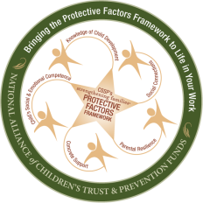
Bringing the Protective Factors
Framework to Life in Your Work
Online training to support implementation of Strengthening Families™ Protective Factors Framework in multiple settings
Systems may use for awarding CEUs, credit
Free of charge
Find at www.ctfalliance.org/onlinetraining
Contact onlinelinetraining@ctfalliance.org

Slide 28

Bringing the Protective Factors
Framework to Life in Your Work
7 courses,
each about
2 hours in length
  Introduction to the Framework (also useful as a stand-alone orientation)
  A course on each of the 5 Protective Factors
  A wrap-up course that moves users from knowledge to action
Find at www.ctfalliance.org/onlinetraining
Contact onlinelinetraining@ctfalliance.org

Slide 29

Resources
Strengthening Families National Network
www.strengtheningfamilies.net
Online Modules : www.ctfalliance.org

Slide 30
The Pennsylvania Child Welfare Practice Model

Slide 31
Take a Moment and Think About This…
What do you hope to achieve when you work with children, youth and families or when an agency works with you?
What common goals do we have?
How do we reach our goals?
Notes:
Before we begin, I want to take a minute to brain storm with you and ask you a few simple questions….
FLIPCHART group exercise to get to the point – What? – ask them to define their outcomes they want to achieve with families and how they do that to highlight our outcomes and our skills needed that we have in the practice model and measure in the QSR protocol)

Slide 32
What is a “Practice Model” ?
At its most basic level, a child welfare practice model is a conceptual map and organizational ideology of how agency employees, families, and stakeholders should unite in creating a physical and emotional environment that focuses on the safety, permanency, and well-being of children, youth and families.
Notes:
Practice models guide the work of a child welfare agency and improve outcomes for children, youth and families. Practice models are the basic principles and approaches that guide an agency’s work.

Slide 33
What is a “Practice Model” ?
The practice model should make an explicit link connecting the agency’s policy, practice, training, supervision, and quality improvement with its mission, vision, agency values, and strategic plan.
It is the agency’s guide to the daily interactions among employees, children, youth, families, stakeholders, and community partners working together to achieve defined outcomes.

Slide 34
A Clearly Articulated
Practice Model Helps Child Welfare Executives, Administrators And Managers:
• Identify outcomes they hope to achieve
• Develop a vision
• Decide how to use agency resources
• Define staff performance expectations
• Develop an array of services
• Create a qualitative case review system
• Collaborate with families and youth
• Work across systems.
“Guide for Developing and Implementing Child Welfare Practice Models” by Jan McCarthy, MSW October, 2012 National Child Welfare Resource Center for Organizational Improvement
Notes:
Slides 6-7-8-9 are from the “GUIDE FOR Developing and Implementing Child Welfare Practice Models” by Jan McCarthy, MSW October, 2012 National Child Welfare Resource Center for Organizational Improvement A service of the Children’s Bureau, a member of the T/TA Network UNIVERSITY OF SOUTHERN MAINE Muskie School of Public Service

Slide 35
A clearly articulated practice model helps supervisors fulfill their role as keepers of the agency’s culture with responsibility for:
• Training, guiding and supporting frontline staff;
• Monitoring and assessing staff performance and child/family outcomes;
• Modeling the agency’s values and approach to working with families; and
• Observing and advocating for needed change.
“Guide for Developing and Implementing Child Welfare Practice Models” by Jan McCarthy, MSW October, 2012 National Child Welfare Resource Center for Organizational Improvement

Slide 36
A clearly articulated practice model gives child welfare workers:
• A consistent basis for decision making;
• Clear expectations and values for their approach to working with families, children, and youth;
• A focus on desired outcomes;
• Guidance in working with service providers and other child-serving systems; and
• A way to evaluate their own performance.
“Guide for Developing and Implementing Child Welfare Practice Models” by Jan McCarthy, MSW October, 2012 National Child Welfare Resource Center for Organizational Improvement

Slide 37

A clearly articulated practice model encourages the community, the agency’s network of stakeholders, and children, youth and families to engage with the agency in fulfilling its mission.
“Guide for Developing and Implementing Child Welfare Practice Models” by Jan McCarthy, MSW October, 2012 National Child Welfare Resource Center for Organizational Improvement
Notes:
Refer to PA’s Practice Model

Slide 38


PA
Child Welfare Practice Model
Strengthening Families
Permanency
FOR PENNSYLVANIA’S CHILDREN, YOUTH AND FAMILIES

Slide 39

Pennsylvania’s Child Welfare
Practice Model
We believe the Practice Model will serve to improve practice and ultimately result in better services and outcomes for children, youth and families
The Practice Model can serve as the keystone to connect and link our values with our efforts at improving outcomes
Successful implementation is critical.
Notes:
Your brainstorming at the beginning of this session identified exactly those things that make up PA’s Practice Model! It is NOT something NEW.
A lot of good work including teaming and engaging already happening across the state and this Practice Model is not a new initiative, rather this model supports and reinforces that good work. This Practice Model purposefully aligns with other work and practices happening in PA and can serve as the keystone to connect all our great efforts.
Our values and principles need to be in place to continue to move forward with CQI – with this keystone in place (our Practice Model), we are better prepared to move forward.
What we do with implementation is the key if the practice model is to become something useful.

Slide 40
Pennsylvania’s Child Welfare Practice Model
Key Components :
  Outcomes
  Values & Principles
  Skills
Notes:
See handout of PA Child Welfare Practice Model. Key Components of PA’s Practice Model: There are 3 key components to the Practice Model 1. Outcomes, 2.Values & Principles, and 3. Skills
The vision defines the goal and purpose of the agency and provides a framework for the strategic planning process by defining the results the agency hopes to achieve.
Guiding values and principles determine what agency services and systems look like and how services are delivered.
Core intervention components and practice skills form the agency’s approach to working with families, youth and children.
Outcomes for children, youth and families are connected to the agency’s vision and principles.

Slide 41
Pennsylvania’s Child Welfare Practice Model
Outcomes:
Children, youth, families, child welfare representatives and other child and family service partners participate as team members with shared community responsibility to achieve and maintain the outcomes.
Notes:
Outcomes: Children, youth, families, child welfare representatives and other child and family service partners participate as team members with shared community responsibility to achieve and maintain the following:
Safety from abuse and neglect.
Enduring and certain permanence and timely achievement of stability, supports and lifelong connections.
Enhancement of the family’s ability to meet their child/youth’s wellbeing, including physical, emotional, behavioral and educational needs.
Support families within their own homes and communities through comprehensive and accessible services that build on strengths and address individual trauma, needs and concerns.
Strengthened families that successfully sustain positive changes that lead to safe, nurturing and healthy environments.
Skilled and responsive child welfare professionals, who perform with a shared sense of accountability for assuring child-centered, family-focused policy, best practice and positive outcomes.

Slide 42
Pennsylvania’s Child Welfare Practice Model
  Children, Youth and Families
  Community
  Honesty
  Cultural awareness and responsiveness
  Respect
  Teaming
  Organizational excellence
Values and Principles:
Our values and principles will be consistently modeled at every level and across partnerships. We believe in…
Notes:
Values and Principles: Our values and principles will be consistently modeled at every level and across partnerships. We believe in…
Children, Youth and Families
Children and youth have the right to live in a safe, nurturing and stable family.
Families are the best place for children and youth to grow up.
Family connections are maintained whenever possible.
All families have strengths.
Families come in all shapes and sizes and family defines family.
Families are experts on themselves, are involved in decision making, and are willing to drive change.
Community
Community is broadly defined. This includes, but is not limited to, families, neighbors, volunteers, spiritual, educational, medical, behavioral health and legal partners.
Natural partnerships must exist within a community to promote prevention, protection, well-being and lifelong connections.
Honesty
Honesty serves as the basis for building trusting relationships.
Honesty is not only telling the truth, but also sharing information, clarifying roles and responsibilities and transparent decision making.
Honesty is an open and consistent exchange of communication in a way that everyone can understand.
Cultural awareness and responsiveness
Culture is respected, valued and celebrated.
Culture is broadly defined. This includes but is not limited to families’ beliefs, values, race, gender, socio-economic status, ethnicity, history, tribe, religion/spirituality/affiliations, sexual orientation and language.
Cultural identity is explored with the family. Each child, youth and family is served with sensitivity within their unique context.
Respect
Everyone has their own unique perspective, the right to be heard and contribute to their success.
Every individual is treated with dignity and consideration.
Teaming
Children, youth and families are best served through a team approach with shared responsibilities. All team members have a role and voice. Involving the child, youth, family and extended support networks as active members of the team empowers the family.
Teams are strength-based and collaborate toward common goals.
Teams change as needed to include all formal and informal supports and resources.
Team members are accountable for their actions, keeping commitments and following through with agreed upon responsibilities.
Organizational excellence:
Engaging children, youth and families, as an involved part of an accepting and empathetic team who can confront difficult issues, will effectively assist in the process toward positive change.
Advocating for and empowering children, youth, families and communities strengthen the organization.
Building, supporting and retaining a qualified, skilled and committed workforce whose own well being and safety are valued is essential.
Responsible allocation and management of resources demonstrates accountability.
Quality practice is assured by consistently monitoring and improving performance through critical self reflection and accountability.

Slide 43
Pennsylvania’s Child Welfare Practice Model
Skills:
To achieve our desired outcomes and commitment to these values and principles, demonstration of the following skills is essential across all aspects of the child welfare system.
  Engaging
  Teaming
  Assessing and Understanding
  Planning
  Implementing
  Monitoring and Adjusting
Notes:
Skills: To achieve our desired outcomes and commitment to these values and principles, demonstration of the following skills is essential across all aspects of the child welfare system.
Engaging: Effectively establishing and maintaining a relationship with children, youth, families and all other team members by encouraging their active role and voice and successfully accomplishing sustainable shared goals.
Teaming: Engaging and assembling the members of the team, including the family, throughout all phases of the change process and based on current needs and goals. Teaming is defining and demonstrating a unified effort, common purpose and clear roles and responsibilities that support positive change.
Assessing and Understanding: Gathering and sharing information so the team has a common big picture of the strengths, challenges, needs and underlying issues. Assessing includes thinking critically and using information to keep the team’s understanding current and comprehensive.
Planning: Applying information gathered through assessment and monitoring to develop an individualized well reasoned sequence of strategies and supports to achieve the agreed upon goals.
Implementing: Actively performing roles to ensure the formal and informal resources, supports and services, identified in the plan, occur in a timely manner and with sufficient intensity, frequency and sequence to produce sustainable and beneficial results.
Monitoring and Adjusting: Continuously analyzing and evaluating the impact and effectiveness of the plan implementation and modifying accordingly in response to the changing successes and needs until goals are achieved.

Slide 44
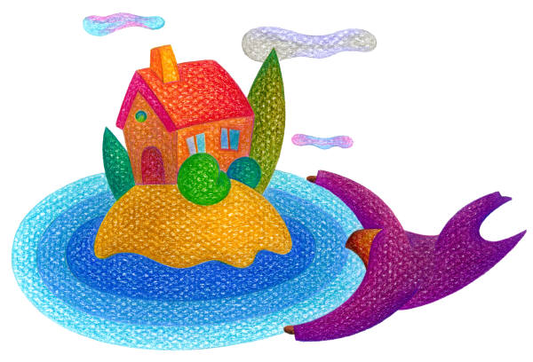
How Will We Know When We Got There?
The outcomes of safety, permanence and well-being for the children, youth and families whom we serve will be achieved by the use of the best quality of services we have provided.
Notes:
How will we know when we have succeeded?

Slide 45
Child/Youth & Family Status Indicators
Safety – Exposure to Threats of Harm
Safety – Risk to Self/Others
Stability
Living Arrangement
Permanency
Physical Health
Emotional Well-Being
Early Learning and Development and Academic Status
Pathway to Independence
Parent and Caregiver Functioning

Slide 46
Practice Performance Status Indicators
Engagement Efforts
Role and Voice
Teaming
Cultural Awareness and Responsiveness
Assessment and Understanding
Long-Term View
Child, Youth and Family Planning Process
Planning for Transitions and Life Adjustments
Efforts to Timely Permanency
Intervention Adequacy and Resource Availability
Maintaining Family Connections
Tracking and Adjusting

Slide 47
Continuous Quality Improvement
What it isn’t and what it is…
Continuous Quality Improvement (CQI) is not a time limited project or initiative.
It is the ongoing process by which an agency makes decisions and evaluates its progress.
Notes:
What is CQI – Continuous Quality Improvement (CQI) is not a time limited project or initiative. It is the ongoing process by which an agency makes decisions and evaluates its progress – it is the WAY in which we will ASSESS and MONITOR if we are being true to our practice model.

Slide 48

The DAPIMTM Model:
A “Flywheel”
Define
Monitor
Assess
Performance
& Capacity
Implement
Plan
© 2009 American Public Human Services Association
Notes:
How are we going to get there? DAPIM is nothing but a framework for how we will do our work at ALL levels (from casework to state executive level) and by keeping with this framework we will all have a common approach that we will all understand and use to move our efforts foreword.

Slide 49
Our goal: To help everyone understand how we are all fellow villagers working together as a team to help raise the children and youth of Pennsylvania.

Slide 50
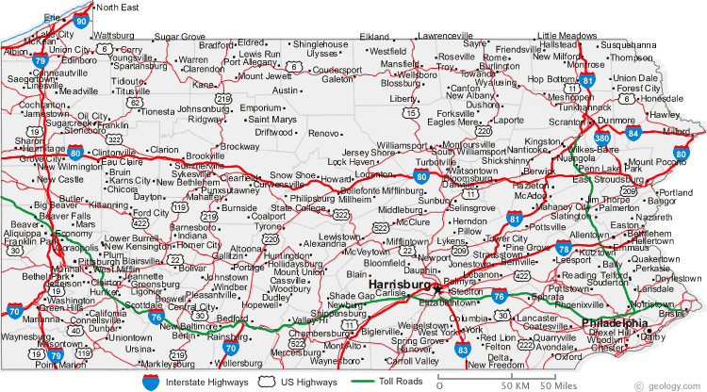
Here’s the map! Pick a village.
We are all working together to help raise the children and youth of Pennsylvania!

Slide 51




Contact
Karen Shanoski
Family Support Project Manager
Center for Schools and Communities
275 Grandview Ave., Suite 200
Camp Hill, PA 17011
kshanoski@csc.csiu.org
717-763-1661 x 139
PA Strengthening Families : Toolkit for Educators
www.pa-strengthening-families.org
Notes:
Federal Agencies
Administration for Children, Youth and Families, Office on Child Abuse and Neglect
Substance Abuse and Mental Health Services Administration (SAMHSA)
Administration on Children and Families, Child Care Bureau
Maternal and Child Health Bureau
Centers for Disease Control and Prevention, Division of Violence Prevention

Slide 52

Please contact us if you have any additional questions
Jeanne Schott jls192@pitt.edu or
Stephanie Maldonado smaldonado@pa.gov

Slide 53

Thank you…
Notes:
10 minutes for any questions from the audience

