Slide 1
308: Adult Mental Health
An Introduction for Child Welfare Professionals

Slide 2
Agenda
Day One
  Welcome and Introduction to Adult Mental Health
  DSM-5
  Crosswalk between the Adult Mental Health and Child Welfare Systems
  Adult Mental Health Disorders

Slide 3
Agenda (continued)
Day Two
  Adult Mental Health Disorder (cont.)
  Dual Diagnosis and Co-Morbidity
  Engaging Families
  Services for Families Dealing with Adult Mental Health
  Wrap-Up and Evaluations

Slide 4
Learning Objectives
Name the laws and regulations that are associated with adult mental health issues
Recognize how and when a caseworker needs to intervene to assure safety, permanency, and well-being for children/adolescents
Identify the diagnostic criteria for adult mental health disorders and how they manifest behaviorally
Determine connections between the behavioral indicators for adult mental health disorders and child safety and risk

Slide 5

Mental Health is…
…a state of successful performance of mental function, resulting in productive activities, fulfilling relationships with other people, and the ability to adapt to change and to cope with adversity. Mental health is indispensable to personal well-being, family and interpersonal relationships, and contribution to community or society.
U.S. Department of Health and Human Services. (1996). Mental Health: A Report of the Surgeon General. Rockville, MD: U.S. Department of Health and Human Services, Substance Abuse and Mental Health Services Administration, Center for Mental Health Services, National Institutes of Health, National Institute of Mental Health.

Slide 6
Results of Ice Breaker Activity
Poster # | Person’s Name | What They Are Known For | Diagnosis
1. | Abraham Lincoln | 16th president | Depression
2. | Lionel Aldridge | Hall of Fame football player for the Green Bay Packers | Paranoid Schizophrenia
3. | Leo Tolstoy | Author of War and Peace | Depression
4. | Winston Churchill | Prime Minister of England | Bipolar
5. | Vivien Leigh | Actress | Bipolar
6. | Sylvia Plath | Poet/Novelist | Depression
7. | Patty Duke | Actress | Bipolar

Slide 7
Results of Ice Breaker Activity (continued)
Poster # | Person’s Name | What They Are Known For | Diagnosis
8. | Charles Dickens | Novelist | Depression
9. | Ernest Hemmingway | Novelist | Depression
10. | Theodore Roosevelt | 26th president | Bipolar
11. | Ted Turner | Businessman | Bipolar
12. | Mike Wallace | Journalist | Depression
13. | Tracy Ullman | Actress/ Comedienne | Bipolar
14. | Brooke Shields | Model/Actress | Postpartum Depression

Slide 8
Results of Ice Breaker Activity (continued)
Poster # | Person’s Name | What They Are Known For | Diagnosis
15. | Michael Jackson | Singer | None
16. | Cesar Chavez | Farm Laborer/Labor Leader/Civil Rights Activist | None
17. | Geronimo | Medicine Man/Apache Warrior | None
18. | Tina Turner | Singer | None
19. | Bjork | Singer | None
20. | Ozzy Osborne | Singer | None

Slide 9
Prevalence of Mental Health in the United States
An estimated 26.2 percent of Americans ages 18 and older — about one in four adults — suffer from a diagnosable mental disorder in a given year.
This figure translates to 57.7 million people. In addition, mental disorders are the leading cause of disability in the U.S. and Canada for ages 15-44.
Many people suffer from more than one mental disorder at a given time. Nearly half (45 percent) of those with any mental disorder meet criteria for 2 or more disorders, with severity strongly related to comorbidity. (NIMH, 2008)

Slide 10
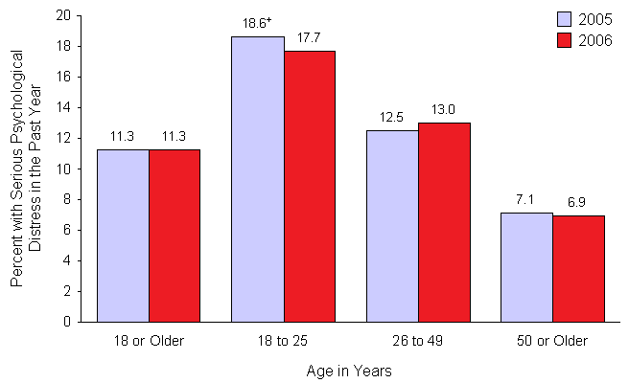
Rates of Serious Psychological Distress
Figure 8.1 Rates of Serious Psychological Distress in the Past Year among Adults Aged 18 or Older, by Age: 2005-2006

Slide 11

Biopsychosocial Model
Temperamental
  Easy, difficult, slow to warm up (Chess & Thomas, 1991)
Environmental
  Family dynamics, parenting styles, larger social systems, adverse life stressors
Genetic and physiological
  Predispositions
  Physical health
(American Psychiatric Association, 2013)

Slide 12
Decision Making Crosswalk
Mental Health | Child Welfare
Referral | Referral
Safety Assessment/Decisions | Safety Assessment/Decisions
Immediate Safety Plan – Is emergency hospitalization necessary? | Immediate, Preliminary Safety Plan – Is emergency placement necessary?
 | Safety Plan – What interventions are necessary to address safety threats?
Diagnostic Evaluation to explore: | Risk Assessment to explore:
Axis I & II - Exploration of symptoms | Child Factors - Exploration of abuse & neglect
Axis III & IV – Medical, Psychosocial and Environmental Factors | Caregiver & Environmental Factors
Axis V –Severity of Symptoms and ability to function | Overall Risk and Severity
Development of a Treatment Plan | Development of a FSP and CPP
Ongoing Mental Health Assessment – medication management, treatment interventions | Review Process – Review, Revise and Implement Plans

Slide 13
Commitments
201 - Voluntary commitment – (Mental Health Procedures Act §7201-7207)
302 - Emergency Involuntary Examination and Treatment – (Mental Health Procedures Act §7302)
303 - Extended Involuntary Emergency Treatment - (Mental Health Procedures Act §7303)
304 - Court Ordered Involuntary Commitment - (Mental Health Procedures Act §7304)

Slide 14
Pennsylvania Mental Health Procedures Regulation
Implements and supplements the Mental Health Procedures Act (50 P.S. § 7101-7503) and the Mental Health and Mental Retardation Act of 1966.
Establishes procedures for treatment of persons with mental illnesses.
Excerpted from Title 55, PA Code, Chapter 5100. www.pacode.com

Slide 15
Pennsylvania Mental Health Procedures Regulation (continued)
Procedures for treatment include:
  Adequate treatment – facility, type of service, etc.
  Treatment facilities – appropriate, approved facilities
  Responsibility to develop and review treatment plan – consumer involved in his/her own treatment plan
  Appeal process
  Contents of treatment plan and review of treatment plan
  Excerpted from Title 55, PA Code, Chapter 5100. www.pacode.com

Slide 16
Pennsylvania Mental Health Procedures Regulation (continued)
Procedures for treatment include:
  Role of Mental Health Review Officer – must be trained in mental health law
  Confidentiality of records – persons over 14 years of age control the release of their records
  Bill of Rights for patients/consumers – rights are posted in every approved MH facility, includes grievance and appeal procedures
  Continuity of care – discharge planning
  Excerpted from Title 55, PA Code, Chapter 5100. www.pacode.com

Slide 17
Pennsylvania Mental Health Procedures Regulation (continued)
Procedures for treatment include (continued):
  Voluntary treatment (examination and treatment; notices; withdrawal discharge and transfer)
  Involuntary treatment (examination and treatment; jurisdiction and venue of legal proceedings; who may be considered for involuntary treatment; standard; admissions to state operated facilities of involuntary committed consumers)
  Procedures for persons charged with a crime or under sentence receiving involuntary or voluntary treatment
  Costs of treatment – establishes liability for treatment costs between the state and the county; also determines county of residence as the county where the consumer had legal address prior to treatment.
  Excerpted from Title 55, PA Code, Chapter 5100. www.pacode.com

Slide 18

Definition of a Safety Threat
A SAFETY THREAT is the conditions or actions within the child’s own home that represent the likelihood of imminent serious harm to the child. A safety threat only exists if it meets the safety threshold.

Slide 19
Definition of a Safety Threshold
SAFETY THRESHOLD is the point when a caregiver’s behaviors, attitudes, emotions, intent, or situations are manifested in such a way that they are beyond being risk influences and have become an imminent threat to child safety. In order to reach the Safety Threshold, a condition must:
    Have potential to cause Serious harm to a child
    Be specific and Observable
    Be Out of control
    Affect a Vulnerable child
    Be Imminent

Slide 20
Types of Protective Capacities
Cognitive Protective Capacity (Thinking): Does the caregiver of origin have the specific knowledge, understanding, and perceptions to protect the child?
Emotional Protective Capacity (Feelings): Does the caregiver of origin have the specific feelings, attitudes, and identification with the child and motivation to protect the child?
Behavioral Protective Capacity (Action): Does the caregiver of origin behave in a manner that is consistent with protecting the child?

Slide 21
Mental Health Affects on Children
Almost 1/3rd of American women and 1/5th of American men provide evidence of psychiatric disorder in the past 12 months. 65% of these women are mothers; 52% are fathers.
Rates of child psychiatric diagnosis among offspring range from 30% to 50%, compared with an estimated rate of 20% among the general child population.
                (Nicholson et al, 2001)

Slide 22
Mental Health Affects on Children (continued)
Research indicates that children who have a parent with mental illness are at significantly greater risk for multiple psychosocial problems.
Children whose parents have a mental illness are at risk of developing social, emotional, and/or behavioral problems.
The environment in which children grow affects their developmental and emotional well-being as much as their genetic makeup does.
                (Nicholson et al, 2001)

Slide 23
Types of Disorders
Depressive Disorders
  Major Depressive Disorder
  Persistent Depressive Disorder (dysthymia)
  With peripartum onset
Bipolar and Related Disorders
  Bipolar I Disorder
  Bipolar II Disorder
  Cyclothymic Disorder
Anxiety Disorder
  Panic Disorder
  Agoraphobia
  Post-Traumatic Stress Disorder
  General Anxiety Disorder

Slide 24
Types of Disorders (continued)
Personality Disorders
  Antisocial Personality Disorder
  Borderline Personality Disorder
Schizophrenia Spectrum and Other Psychotic Disorders
Somatic Symptom and Related Disorders
  Factitious Disorder imposed on self
  Factitious Disorder imposed on another

Slide 25

Mood Episodes
Depressive episode
At least two weeks of depressed mood or loss of interest or pleasure accompanied by at least four additional symptoms of depression:
  Significant weight gain or loss
  Insomnia or hypersomnia
  Observable agitation or slowing
  Fatigue/energy loss
  Feelings of guilt or worthlessness, indecisiveness or inability to concentrate
  Re-current thoughts of death or suicidal ideation, attempt or plan

Slide 26
Mood Episodes (continued)
Manic Episode
Distinct period (at least 1 week) marked by abnormally and persistently elevated, expansive, or irritable mood, plus at least 3 of the following:
  Grandiosity
  Decreased need for sleep
  Pressure of speech
  Flight of ideas
  Distractibility
  Increased goal-directed activity or psychomotor agitation
  Involvement in pleasurable activities with a high potential for painful consequences (e.g. gambling, fast driving, sexual promiscuity)

Slide 27
Mood Episodes (continued)
Hypomanic Episode
At least 4 days of markedly elevated, expansive, or irritable mood.

Slide 28

Bipolar Questions
What answers for bi-polar remained the same? Why or why not?
What answers for bi-polar are different? Why or why not?
What other concerns do you have with the addition of mania?

Slide 29

Anxiety Disorders
Panic Disorder
Agoraphobia
Generalized Anxiety Disorder

Slide 30
Personality Disorders
Cluster A: Characterized by a pervasive pattern of oddness, eccentricity
Cluster B: Characterized by a pervasive pattern of emotionality, drama, and erratic behavior
Cluster C: Characterized by a pervasive pattern of anxiety, fearfulness

Slide 31

Definition of Dual Diagnosis…
A person who has both an alcohol or drug problem and an emotional/psychiatric problem.

Slide 32
Statistics on Dual Diagnosis
Psychiatric Disorder | Increased Risk for Substance Abuse
Antisocial Personality Disorder | 15.5%
Manic Episode | 14.5%
Schizophrenia | 10.1%
Panic Disorder | 4.3%
Major Depressive Episode | 4.1%
Obsessive-Compulsive Disorder | 3.4%
Phobias | 2.4%
National Drug Intelligence Center

Slide 33
Co-Morbidity
The presence of more than one mental health disorder occurring in an individual at the same time.

Slide 34
Co-Morbidity and Mental Illness
45 percent of those with one mental disorder met criteria for two or more disorders.
Major Depressive Disorder is a very common comorbid disorder.
Personality Disorders are often criticized because their comorbidity rates are excessively high, approaching 60%
Comorbidity is also found to be high in drug addicts, both physiologically and psychologically.

Slide 35
Co-Morbidity and Mental Illness (continued)
OCD is sometimes accompanied by depression, eating disorders, substance abuse, or other anxiety disorders.2-4 Symptoms of OCD can also coexist and may even be part of a spectrum of other brain disorders, such as Tourette’s syndrome.
OCD and Schizophrenia have been seen together as the OCD seems to be a coping mechanism that help the person with schizophrenia feel protected.
An association also exists between respiratory diseases and Panic Disorder.

Slide 36
Saleeby Quote…
At the very least, the strengths perspective obligates workers to understand that; however downtrodden or sick, individuals have survived (and in some cases even thrived). They have taken steps, summoned up resources, and coped. We need to know what they have done, how they have done it, what they have learned from doing it, what resources (inner and outer) were available in their struggle to surmount their troubles. (Saleeby, 1992)

Slide 37
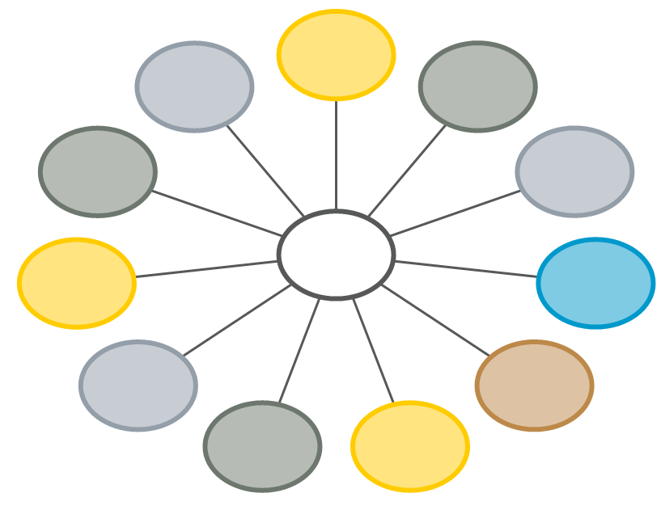
Eco-Maps

Slide 38

Safety Decisions
Safe:
Either caregiver’s existing Protective Capacities sufficiently control each specific and identified Safety Threat or no Safety Threats exist. Child can safely remain in the current living arrangement or with caregiver(s) of origin. Safety plan is not required.
Safe with a Comprehensive Safety Plan:
Either the caregiver(s) of origin existing Protective Capacities can be supplemented by safety actions to control each specific and identified Safety Threat or the child must temporarily reside in an alternate informal living arrangement. No court involvement is necessary; however a Safety Plan is required.

Slide 39

Safety Decisions (continued)
Unsafe:
Caregiver(s) of origin’s existing Protective Capacities cannot be sufficiently supplemented by safety actions to control specific and identified Safety Threats. Child cannot remain safely in the current living arrangement or with the caregiver(s) of origin; County Children and Youth Agency must petition for custody of the child. A Safety Plan is required.

Slide 40
6 Stages of Change
Pre-contemplation – unaware, uninterested or unwilling to make a change e.g. denial
Contemplation – considering the change e.g. on the fence
Determination – deciding and planning to change
Action – making the change
Maintenance – keeping the change going, includes relapse
Termination – permanent change

Slide 41
Parenting Domains
Focus on parenting
Focus on mentally ill parent
Focus on other caregiver, if relevant
Focus on marriage/partnership, if relevant
Focus on the child
Focus on Context

Slide 42

Psychological Evaluations
Psychological evaluations are intended to:
  provide a structured, organized, and succinct description of current psychological functioning
  include cognitive abilities and emotional experience.
Psychological evaluations offer:
  insight as to the severity of a particular disturbance and of the capacity for adequate functioning.
  a formal and structured way of gathering objective information

Slide 43

Psychological Evaluations (continued)
Psychological evaluation may be used to:
  confirm or impressions formed by referring therapists
  modify impressions formed by referring therapists
A Psychological evaluation may identify:
  needs in therapy
  highlight issues that may come up in treatment
  recommend particular forms of intervention
  offer guidance about potential outcomes of treatment
Psychological evaluations typically begin with a clinical interview, and may include any number of psychological tests.

Slide 44

Psychological Evaluations (continued)
Psychological tests can include:
  assessments of personality styles
  tests of emotional well-being
  intellectual (or IQ) tests
  tests of academic achievement
  tests for possible neurological damage
  tests for specific psychological disturbances and their severity
Psychological tests may also include:
  interviews with significant others (such as caregivers, spouses, or social worker)
  a review of past records and relevant documents

Slide 45
Components of a Psychological Evaluation
Reason for the evaluation
History of the present illness
Past psychiatric history
General medial history
History of substance use
Psychosocial/Developmental history (personal history)
Information derived from the interview process

Slide 46
Components of a Psychological Evaluation (continued)
Social history
Occupational history
Family history
Review of symptoms
Physical examination
Mental status examination
Functional assessment
Diagnostic tests

Slide 47
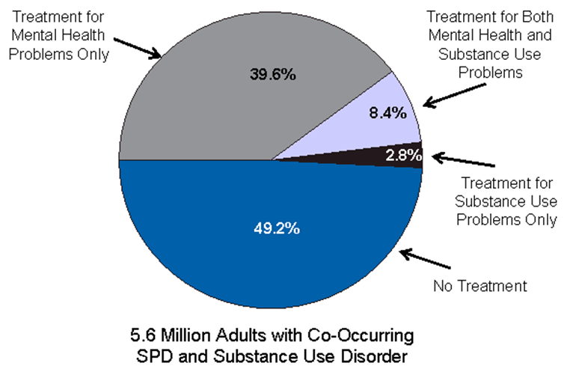
Past Year of Treatment
Figure 8.2 Past Year Treatment among Adults Aged 18 or Older with Both Serious Psychological Distress and a Substance Use Disorder: 2006

Slide 48
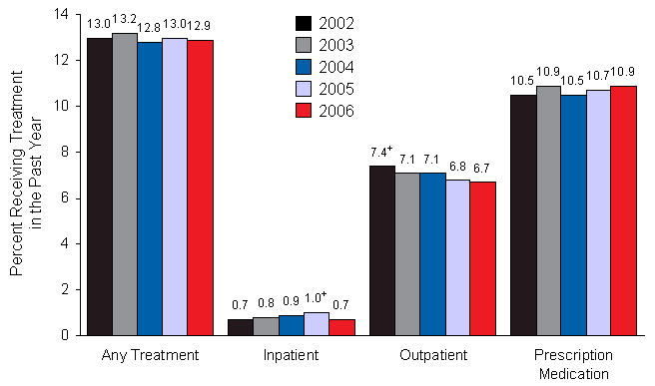
Type of Treatment
Figure 8.6 Past Year Treatment for Mental Health Problems among Adults Aged 18 or Older, by Type of Treatment: 2002-2006

Slide 49
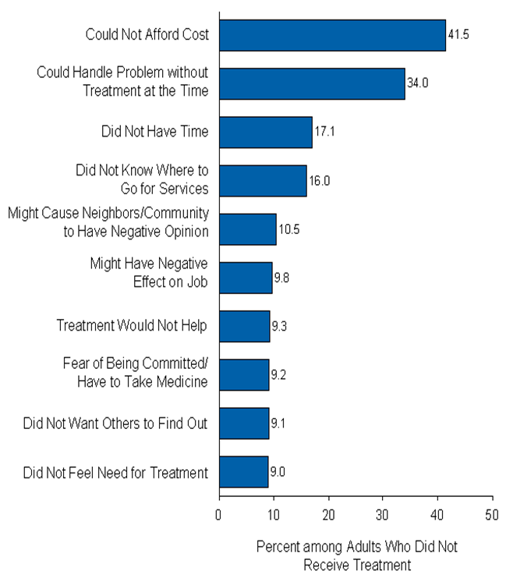
Reasons for Not Receiving Treatment
Figure 8.7 Reasons for Not Receiving Mental Health Treatment in the Past Year among Adults Aged 18 or Older with an Unmet Need for Treatment Who Did Not Receive Treatment: 2006

Slide 50

When a Caregiver Needs Hospitalization
How do you help the caregiver with the mental health needs tell the child about their caregiver’s illness and need for hospitalization?
How might the caregiver feel?
What might be some concerns of the caregiver?
What do you tell the child about how long they will be separated from their caregiver and who will be caring for the child?
What do you tell the child about when they will see their caregiver again?
What other information do they need?

Slide 51
Transfer of Learning
What are two things you learned today that you might apply immediately to your casework?
What are three concepts you plan to share with your supervisor?
Which resources/handouts from your session today do you plan to share with co-workers?

