Slide 1


Slide 2
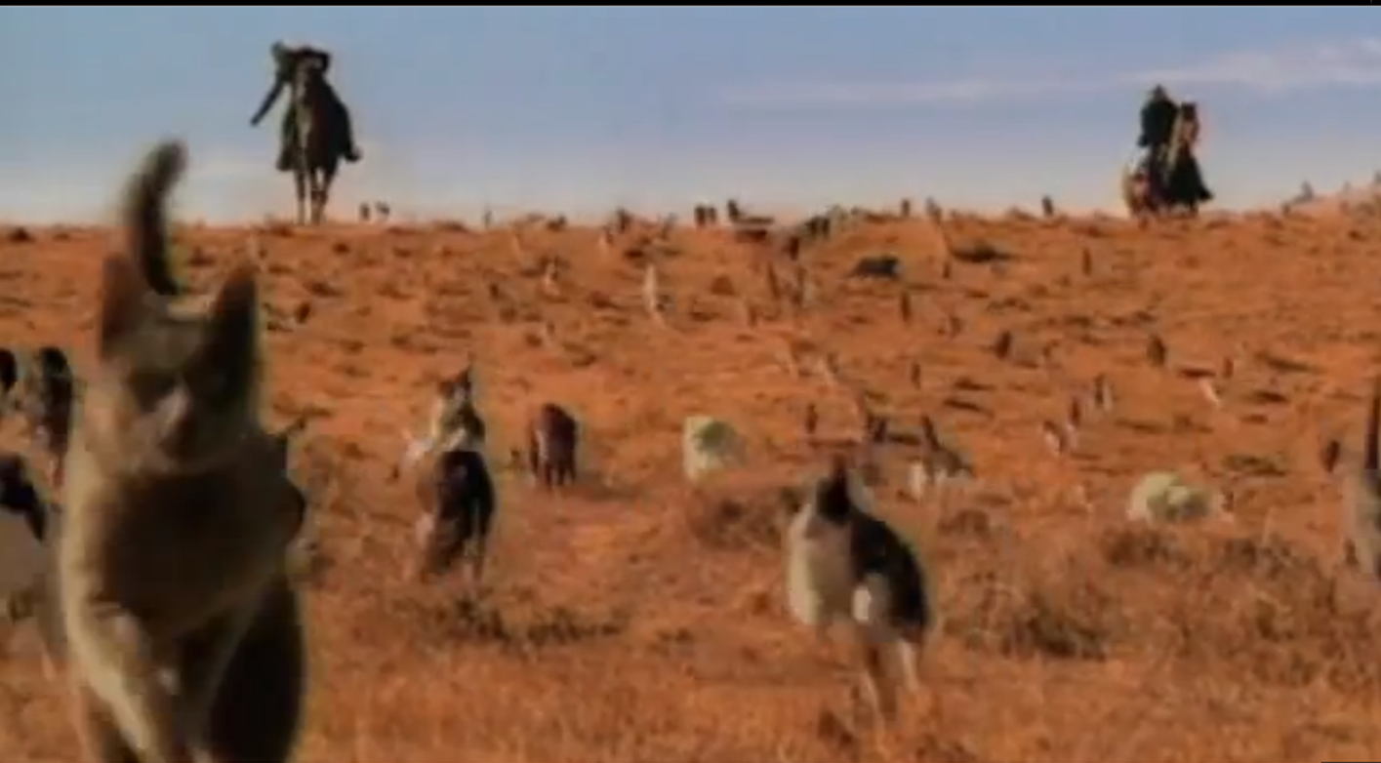
Cat Herders

Slide 3
Learning Objectives
Participants will be able to
Describe success factors for facilitators
Offer ways to incorporate success factors for facilitators into their work as trainers

Slide 4

Agenda
Introductions and Workshop Overview
Why Do We Do It and What Is It
Success Factors for Facilitators
Action Planning

Slide 5
Five Principles of Adult Learning
Self-concept: adult learners are self-directed
Experience: adult learners bring resources to the table
Readiness to learn: Influenced by social and professional role
Orientation to learning: Problem-centered and pragmatic
Motivation to learn: As a person matures the motivation to learn is internal

Slide 6

Two Roles
Trainer
Facilitator
Provides content expertise
Creates timeframe and sequence
Plans based on outcomes
Provides guidance and support
Manages the unexpected as it arises
Develops a repertoire of tools and skills to call on
Here Be
Dragons
Notes:
Ask:
We carry out two related roles: Trainer and Facilitator. So, what is the difference?
Allow a few minutes for comment, and acknowledge contributions to discussion.
Say:
Here is one way to think about the distinction between these two roles: A trainer deals with the known quantities of a learning experience: the things you can predict and plan for in advance. Let’s look at what we have listed here:
Trainers deliver information, the content of the training, and are often experts in the material.
Click
Trainers set up the sequence and decide on the time needed for the activities and information delivery that take place. They set up and maintain the flow.
Click
Trainers map out the path to achieving the desired outcomes of the training, aligning what they plan to say and do with the goals of the learning experience.
Click
Our trainer is the guy with the map.
Ask: But does everything always proceed as planned? What are some things that can happen? Allow a few minutes for comment, and acknowledge contributions to discussion.
Say:
These kinds of things, that happen more often than not, are the unknown side of a given learning experience, and this is the facilitator’s territory.
When we lose our way, the facilitator gets us back on track.
Click
The facilitator helps learners to overcome obstacles and removes barriers.
Click
And, because the facilitator deals with the unexpected and unpredictable things that come up, flexibility, adaptability, and a good toolkit are necessary for success in this job.
Click
Remember what they used to put on maps long ago when the territory ahead was unknown?
It is the facilitator that deals with the occasional dragons.

Slide 7
Psychological & Accountability Performance Matrix
 | Low Accountability | High Accountability
High Safety | Comfort Zone | LEARNING ZONE
Low Safety | Apathy Zone | Anxiety Zone

Slide 8

Action

Slide 9
Questions & Answers

