Slide 1
521: Supervisor Training Series Remote
Module 3: The Middle/Work Phase of Supervision

Slide 2
The Supervisor Training Series
The Preparatory and Beginning Phases of Child Welfare Supervision
Living the Mission of Child Welfare
The Middle/Work Phase of Supervision
Managing Diversity
Endings and Transitions/Managing Staff Retention, Satisfaction, and Separation

Slide 3
Agenda
Day One
Introduction
Managing Time Based on Priorities
Introduction to the Performance Management Cycle
Defining Standards
Assessing Performance
Planning Performance Improvement
Coaching

Slide 4
Agenda (continued)
Day Two
Coaching (continued)
The Middle/Work Phase Skills
The Strength-Based, Solution-Focused Approach

Slide 5
Agenda (continued)
Day Three
Reflective Supervision
Supporting Critical Thinking
The Teacher and Learner

Slide 6
Agenda (continued)
Day Four
Putting it All Together
Transfer of Learning
Introduction to Foundations of Child Welfare Practice
Performance Evaluations
Transferring of Learning and Evaluation

Slide 7
Learning Objectives
Participants will be able to:
Describe organizational and time management methods to balance multiple priorities;
Identify the steps in the Performance Management Cycle;
Recognize methods to assess, support and enhance staff’s commitment, confidence and competence;
Discuss the importance of coaching when learning a new skill;
Identify skills to provide culturally specific feedback to supervisees;

Slide 8
Learning Objectives (continued)
Participants will be able to:
Discuss the Interactional Helping Skills used in the Middle/Work Phase;
Identify the seven key strategies and associated skills from the Solution-Focused approach.
Explain the importance of using reflective supervision techniques;
Explain the supervisor’s role in the learning cycle;

Slide 9
Learning Objectives (continued)
Identify supervisor pre- and post training techniques that facilitate the transfer of learning process;
Recognize the structure of “Foundations” as a strength-based, solution- focused method of training new Child Welfare Professionals;
Recognize their supervisory responsibility to support and mentor new Child Welfare Professionals who are attending “Foundations”; and
Identify the steps in a performance evaluation.

Slide 10
Roles of Supervision
Administrative Supervision
Educational Supervision
Clinical Supervision

Slide 11
Educational Supervision
Educational Supervision focuses on educating workers in order to attain more competent and confident workers. This type of supervision emphasizes the development and/or enhancement of the child welfare professional’s knowledge and skills.

Slide 12
Clinical Supervision
Clinical supervision focuses on the work that caseworkers do with children and families. Good clinical supervision is supportive, nurturing, and motivating in helping workers to attain a high level of performance. It is critical to building worker competencies, including reinforcing positive social work ethics and values, encouraging self-reflection and critical thinking skills, and supporting the worker through casework decision-making and crises.
In clinical supervision, a supervisor and worker together reflect on the skills used and theory applied by the worker with a family in assessing, planning, implementing, and monitoring change.
(Child Information Gateway, 2011)

Slide 13
Idea Catcher
Don’t let a good idea get away!
People remember:
20% of what they hear
30% of what they see
70% of what they say
90% of what they do

Slide 14
Goethe’s Quote
“Things which matter most must never be at the mercy of things which matter least.”

Slide 15
Avoid Performing Purposeless Activities
Don’t just do it to be doing it;
Don’t mistake the activity for the results; and
Keep it relevant.

Slide 16
The Urgency Index
0-25 low urgency mindset
26-45 strong urgency mind-set
46+ urgency addiction
Copyright 1994, Franklin Covey, Reprinted with permission of Franklin Covey from First Things First, 1st ed., Steven R. Covey, A. Roger Merrill, and Rebecca R. Merrill, Simon & Schuster Adult Publishing Group.

Slide 17
Don’t prioritize your schedule, but instead schedule your priorities.
(Covey, 1994)

Slide 18
High Performance and Typical
 | Urgent | Not Urgent
Important | I 20-25% | II 65-80%
Not Important | III 15% | IV Less than 1%
25-30%
15%
50-60%
2-3%

Slide 19
Seven Key Activities
Improving communication with people
Better preparation
Better planning and organizing
Taking better care of self
Seeking new opportunities
Personal development
Empowerment
Copyright 1994, Franklin Covey, Reprinted with permission of Franklin Covey from First Things First, 1st ed., Steven R. Covey, A. Roger Merrill, and Rebecca R. Merrill, Simon & Schuster Adult Publishing Group.

Slide 20
Put First Things First
At the beginning of each day:
Preview the day;
Prioritize; and
Separate time-sensitive activities from activities that can be done any time.
Copyright 1994, Franklin Covey, Reprinted with permission of Franklin Covey from First Things First, 1st ed., Steven R. Covey, A. Roger Merrill, and Rebecca R. Merrill, Simon & Schuster Adult Publishing Group.

Slide 21
The Goal of Performance Management
CONTINUOUS QUALITY IMPROVEMENT

Slide 22
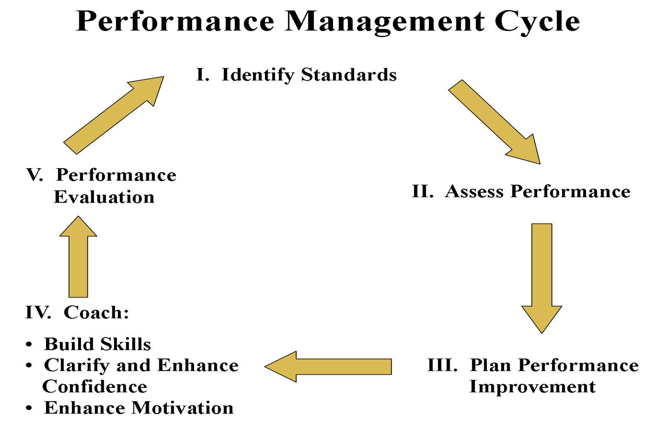

Slide 23
Points on Clarifying Expectations
Never assume expectations are clear;
Everyone needs to take responsibility for clarifying expectations while being culturally competent;
Statements must be clear, specific and measurable;
Listen to staff's ideas, negotiate the final standard, and support of staff’s actions.
Always contract with employees to give and receive feedback when they are first hired. This contract should be renegotiated regularly to encourage honest and open communication.

Slide 24
Standards Must Be:
Specific;
Measureable;
Action Oriented;
Realistic; and
Time-limited.

Slide 25
Group Instructions
Identify one standard that serves as the best example of a well-written standard.
Identify one standard that caused the group the greatest challenge to refine.
Record on flip chart papers the two standards.

Slide 26
Typical Causes of Performance Gaps
Lack of competence;
Lack of confidence; and
Lack of commitment.

Slide 29
Potential Solutions for Knowledge Deficits
Ignore the problem
Training and transfer of learning activities
Additional practice and feedback
Change the job
Informal on-the-job training
Mentor
Transfer or termination

Slide 30
Potential Solutions for Execution/Performance Deficits
Ignore the problem
Remove or minimize barriers
Provide praise when done correctly
Provide encouragement
Connect the desired performance to the shared vision, mission, and values system
Arrange appropriate consequences

Slide 31
Potential Solutions for Execution/Performance Deficits (continued)
Refer to outside services
Remove or minimize rewards for undesired performance and balance this also with rewards for desired performance
Remove or minimize punishments for desired performance and balance this with appropriate rewards

Slide 32
What types of interventions might be best to help Sophia improve her performance?

Slide 33
What is Coaching?
Coaching is an intervention that reduces the impact of performance problems due to lack of skills, knowledge, and motivation. It may also be used to enhance performance that is already satisfactory.
(Seymour, 1994)

Slide 34
What is Coaching (continued)?
In coaching, one person improves the performance of another by:
questioning,
collaborative goal setting,
systematic observation, and
motivational and constructive feedback, and positive guidance.
(Seymour, 1994)

Slide 35
Brainstorm a list of characteristics of an effective coach.

Slide 36
What is a Coach?
A person who is responsible for guiding other people to winning results through a continual process of discovering individual’s strengths and weaknesses and matching information, resources, advice, and understanding to those needs.
(Seymour, 1994)

Slide 37
An Effective Coach is...
Positive;
Enthusiastic;
Supportive;
Trusting;
Focused;
Goal-oriented;
Observant;
Respectful;
Patient;
Clear; and
Assertive.

Slide 38
Attitude Yields Attribute
Assume the attitude and you will
develop the attribute.

Slide 39
Steps to Effective Coaching
Step 1: Name the purpose or challenge and describe the desired outcome
Step 2 : Assess/Brainstorm possible approaches
Step 3: Develop a plan of action
Step 4: Set deadlines
Step 5: Establish standards/criteria for evaluation
Step 6: Facilitate action
Step 7: Follow through

Slide 40
Agenda
Day One
Introduction
Managing Time Based on Priorities
Introduction to the Performance Management Cycle
Defining Standards
Assessing Performance
Planning Performance Improvement
Coaching

Slide 41
Agenda (continued)
Day Two
Coaching (continued)
The Middle/Work Phase Skills
The Strength-Based, Solution-Focused Approach

Slide 42
Agenda (continued)
Day Three
Reflective Supervision
Supporting Critical Thinking
The Teacher and Learner

Slide 43
Agenda (continued)
Day Four
Putting it All Together
Transfer of Learning
Introduction to Foundations of Child Welfare Practice
Performance Evaluations
Transferring of Learning and Evaluation

Slide 44
Steps to Effective Coaching
Step 1: Name the purpose or challenge and describe the desired outcome
Step 2 : Assess/Brainstorm possible approaches
Step 3: Develop a plan of action
Step 4: Set deadlines
Step 5: Establish standards/criteria for evaluation
Step 6: Facilitate action
Step 7: Follow through

Slide 45
Environmental Benefits of Coaching
Fosters productive working relationships;
Provides opportunities for conveying appreciation;
Fosters self-coaching behaviors; and
Improves employee performance and morale.
(Cook, 1999)

Slide 46
Considerations for Coaching Employees with Disabilities
Coach regularly.
Make training materials, activities, facilities and instructions are accessible
Adapt your one-on-one coaching technique.
Give effective feedback.
Provide professional development opportunities.
Determine necessary accommodations.
Assign a peer coach.

Slide 47
Two Focus Areas in Individual Supervision
Worker professional development
Case supervision.

Slide 48
Supervisory Conferences: How Often?
Difficulty of the specific standards assigned;
How structured or unstructured is the work environment;
Number of alternatives, or how repetitious or how different each time is the policy application; and
The combined degree of employee competence, confidence and commitment.

Slide 49
Sessional Tuning-In Skills
Tuning In to Self
Tuning In to Others
Responding to indirect cues
(Shulman, 2010)

Slide 50
Sessional Contracting Skills
Preparing of agendas for individual conference or group meeting
Inquire what the staff would like to discuss
Allowing staff to voice concerns at the beginning of the session prevents the illusion of work
(Shulman, 2010)

Slide 51
Elaboration Skills
Moving from general to specific
Containment
Focused listening
Questioning
Reaching into silences
(Shulman, 2010)

Slide 52
Focused Listening
What part of Fred’s message would be your focus?
What would you do or say next?

Slide 53
Sources of Job-Related Tension
Administrative pressures
Educational supervision challenges to long held positions
The supervisor-supervisee relationship
Client relationship pressures
The nature and context of the task
(Kadushin, 1992)

Slide 54
Empathy Skills
Reaching for feelings
Acknowledging feelings
Articulating workers’ feelings
(Shulman, 2010)

Slide 55
Barriers to Using Empathy Skills
It requires that supervisors to be in touch with their own feelings;
The feeling that it is unprofessional to have close relationships with their staff;
The belief that empathy should be reserved for therapy; and
A lack of clarity about their function and purpose of supervision.
(Shulman, 2010)

Slide 56
Skills in Sharing own Feelings
Showing vulnerability
Showing anger
(Shulman, 2010)

Slide 57
Transference
The redirection of feelings and desires and especially of those unconsciously retained from childhood toward a new object.
(Webster's New Collegiate Dictionary, 1976)

Slide 58
Counter-transference
The projection of one’s own unresolved conflicts onto a client.
(Webster's New Collegiate Dictionary, 1976)

Slide 59
Counter-transference in Our Work
What instances of counter-transference have you already been able to identify in work with your staff?
How it was that they became aware of these feelings?

Slide 60
Instructions
Review the respective skill factor on the handout.
Discuss.
Prepare to explain each of the related skills to the rest of the group and how it can be applied in supervision.

Slide 61
Skills in Making a Demand for Work
Facilitative confrontation
Partializing the worker’s concerns
Holding to focus
Checking for underlying ambivalence
Challenging the illusion of work
(Shulman, 2012)

Slide 62
Skills in Pointing Out Obstacles
Exploring taboo areas
Dealing with the authority theme
(Shulman, 2012)

Slide 63
Skills in Sharing Data
Providing relevant data
Monitoring the learning process
Presenting data in a way open to challenge
(Shulman, 2012)

Slide 64
Sessional Ending Skills
Summarizing
Generalizing
Identifying next steps
Rehearsing
Identifying doorknob communications
(Shulman, 2012)

Slide 65
How is the Strength-Based, Solution Focused Approach Helpful?
The modeling of it by supervisors at the unit and worker levels (parallel process) promotes a positive vision of the future and measurable progress built on strengths;
The questions provide information about the worker’s competency level; and
It promotes a sense of partnership and mutual responsibility for a worker’s professional development.

Slide 66
Types of Questions
Exception Questions
Coping Questions
Indirect Questions
Scaling Questions
Miracle Questions
(Berg & Kelly, 2000)

Slide 67
Agenda
Day One
Introduction
Managing Time Based on Priorities
Introduction to the Performance Management Cycle
Defining Standards
Assessing Performance
Planning Performance Improvement
Coaching

Slide 68
Agenda (continued)
Day Two
Coaching (continued)
The Middle/Work Phase Skills
The Strength-Based, Solution-Focused Approach

Slide 69
Agenda (continued)
Day Three
Reflective Supervision
Supporting Critical Thinking
The Teacher and Learner

Slide 70
Agenda (continued)
Day Four
Putting it All Together
Transfer of Learning
Introduction to Foundations of Child Welfare Practice
Performance Evaluations
Transferring of Learning and Evaluation

Slide 71
Reflective Supervision
A collaborative relationship for professional growth that improves program quality and practice by cherishing strengths and partnering around vulnerabilities to generate growth.
(Shahmoon-Shanok, 2009)

Slide 72
Reflection
Stepping back from the immediate experience to sort through thoughts and feelings about what one is observing and doing with children and families.
(Fenichel, 1992)
Nova scienceNOW Mirror Neurons

Slide 73
Prevalence of Secondary Trauma in Our Work
55% of child welfare professionals have at least one core symptom clusters (group of symptoms) of Post-Traumatic Stress Disorder (PTSD)
Almost 16% of workers meet the criteria for PTSD.
(Bride, 2007)

Slide 74
What Does the Word “Trauma” Mean?
The Greek word for “wound”
An injury (as a wound) to living tissue caused by an extrinsic agent.
A disordered psychic or behavioral state resulting from severe mental or emotional stress or physical injury.
(Merriam-Webster, 2012)

Slide 75
The Three Elements of Reflective Supervision
Collaboration
Regularity
Reflection
(Parlakian, 2001)

Slide 76
Jeree Pawl’s Platinum Rule of Reflective Supervision
Do Unto Others As You Would Have Others Do Unto Others.
(Pawl, 1995)

Slide 77
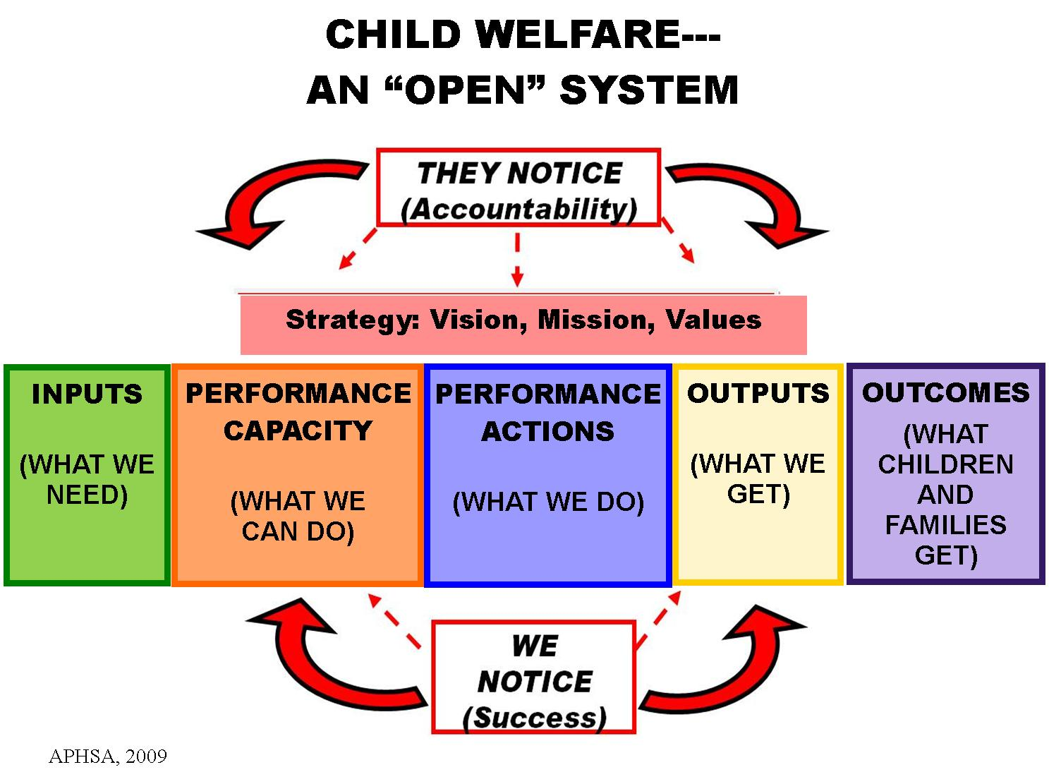

Slide 78
Techniques that Facilitate Reflection on Applying Skills
Memory work
and
Process recordings

Slide 79
Shulman’s Quote
“It is not possible to develop practice skills in working with clients or supervision of staff without some ongoing means of examining the details of one’s practice efforts.”

Slide 80
Memory Work
What happened?
How did you feel when she said that?
What did you say back?

Slide 81
Memory Work Discussion
Discuss any experiences you have had conducting memory work with your staff.
Has this technique affected your worker’s practice or decision-making abilities?
If so, how?

Slide 82
What is Process Recording?
It involves creating a written record of an interview including:
All verbal and non-verbal communication;
The child welfare professional’s feelings throughout the interview; and
Supervisor’s constructive and motivational feedback.

Slide 83
Process Recording Questions
Can you see yourself using process recordings as a supervisor?
What might be the benefits to using process recordings?
What are the barriers?
Are there any specific situations when process recording might be helpful?

Slide 84
Practical Considerations
Complete recordings as soon as possible after the interview;
Afford the worker the time to do it;
Discuss the process recording with the worker before the next client interview; and
Ensure that process recordings do not become part of the client’s permanent record.
(Wilson, p. 55, 1976 Ed.)

Slide 85
Reflective Supervision Results in:
Decreased incidence of burnout;
Staff retention;
Increased hope for families;
Increased permanent placements for children;
Increases self-awareness of worker;
Increase in learning;
Increased empathy for clients;
Workers use the same skills with clients (parallel process).
(Turner, 2009.; National Council on Delinquency, 2006, www.multiplyingconnections.org, Shamoon-Shanok, 2011).

Slide 86
Critical Thinking Defined
Seeing both sides of an issue, being open to new evidence that disconfirms your ideas, reasoning dispassionately, demanding that claims be backed by evidence, deducing and inferring conclusions based on available facts (and) solving problems.
(Willingham, 2008).

Slide 87
Thinkers’ Thoughts on Thinking
“Thinking is the hardest work there is, which is the probable reason so few engage in it.”
Henry Ford
“ Many people think they are thinking when they are merely rearranging their prejudices.”
William James

Slide 88
Tasks of Critical Thinkers
Provide a clear focus on the question or problem
Increase self-awareness and the recognition of cognitive biases
Judge the credibility of sources of information
Analyze and evaluate information
Formulate well-reasoned conclusions and decisions
Communicate clearly and thoughtfully
(University of Pittsburgh, 2011)

Slide 89
Three Ways to Use the Guide
Worker need
Department/unit focus area
Supervisory skill development

Slide 90
Child/Youth and Family Status Indicators
Practice Performance Indicators
Safety: Exposure to Threats of Harm
Safety: Risk to Self/Others
Stability
Living Arrangement
Permanency
Physical Health
Emotional Well-Being
Early Learning and Development
Academic Status
Pathway to Independence
Parent or Caregiver Functioning
Engagement Efforts
Role & Voice
Teaming
Cultural Awareness & Responsiveness
Assessment & Understanding
Long-Term View
Child/Youth & Family Planning Process
Planning for Transitions & Life Adjustments
Efforts to Timely Permanence
Intervention Adequacy & Resource Availability
Maintaining Family Relationships
Tracking & Adjusting

Slide 91
Incorporating Critical Thinking into Supervision
What value would it be to use the Supervisor’s Guide, Quick Tool, and Safety Assessment Quality Assurance Toolkit during supervision?
Do you think that case decisions might look different if these tools were used regularly?
How do you think using these tools in supervision could help a child welfare professional become more confident? Competent?
What do you as a supervisor need to be able to incorporate the use of these tools into your supervisory conferences?

Slide 92
Educational Supervision
Educational Supervision focuses on educating workers in order to attain more competent and confident workers. This type of supervision emphasizes the development and/or enhancement of the child welfare professional’s knowledge and skills.

Slide 93
The Mid-Wife Teacher
Describe the approach a mid-wife teacher would use to impart knowledge.
How would the student experience learning from a mid-wife teacher?

Slide 94
Connected Teaching
Content: what is being discussed in order to achieve the group’s goals.
Process: the sequence of group members’ actions that take place over time and are aimed at achieving the group’s goal.

Slide 95
Connected Learning
Professional/Personal
Subjective/Objective
Content/Process

Slide 96
Characteristics of Adult Learners
Self-Concept
Experience
Center-Time Perspective
Readiness-to-Learn
(Malcolm Knowles, 1984)

Slide 97
Group Instructions
Discuss your assigned characteristic of an adult learner. (Instructional implications and the role of the supervisor in teaching to this adult learner characteristic.
Decide how you wish to “teach” your adult learner colleagues what you discovered during your discussions. (Consider the implications you identified as you decide how to “teach”.)
Each group will have about 5 minutes to “teach” your adult colleagues.

Slide 98
Self-Concept
The adult learner sees herself as capable of self-direction and desires others to see her the same way. In fact, one definition of maturity is the capacity to be self-directing.

Slide 99
Experience
Adults bring a lifetime of experience to the learning situation. Young people tend to regard experience as something that has happened to them, while to an adult, his experience is him. The adult defines who he is in terms of his total life experience.

Slide 100
Readiness-to-Learn
Adult developmental tasks increasingly move toward occupational role competence and away from the more physical developmental tasks of childhood.

Slide 101
Center-Time Perspective
Young people tend to think of education as the accumulation of knowledge for use in the future. Adults tend to think of learning as a way to be more effective.

Slide 103
Learning Styles
Active
Sensing
Visual
Sequential
(Felder & Soloman, 1991)
Reflector
Intuitive
Verbal
Global

Slide 104
Learning Style Inventory
http://www.engr.ncsu.edu/learningstyles/ilsweb.html.

Slide 105
Agenda
Day One
Introduction
Managing Time Based on Priorities
Introduction to the Performance Management Cycle
Defining Standards
Assessing Performance
Planning Performance Improvement
Coaching

Slide 106
Agenda (continued)
Day Two
Coaching (continued)
The Middle/Work Phase Skills
The Strength-Based, Solution-Focused Approach

Slide 107
Agenda (continued)
Day Three
Reflective Supervision
Supporting Critical Thinking
The Teacher and Learner

Slide 108
Agenda (continued)
Day Four
Putting it All Together
Transfer of Learning
Introduction to Foundations of Child Welfare Practice
Performance Evaluations
Transferring of Learning and Evaluation

Slide 109
Recap of Supervisor Approaches So Far
Interactional Helping Skills;
Strength-Based, Solution-Focused Supervision;
Reflective supervision;
Critical thinking;
Teacher/Learner strategies.

Slide 110
What is Transfer of Learning?
Transfer of Learning is the effective and continuing APPLICATION, by trainees to their jobs, of the KNOWLEDGE and SKILLS gained in training.
Broad and Newstrom (1992)

Slide 111
The Learning Partnership
Pennsylvania Child Welfare Resource Center
Supervisor/
Administrator
Trainee

Slide 112
Assumptions about Training
Training is the responsibility of the organization
Training is a management intervention
Training is an investment

Slide 113
The Learning Cycle
Assess
Learning
Needs
Feedback
Identify Learning Methods
Apply
Learning
Prepare for
Learning
Experience Learning

Slide 114
Driving and Restraining Forces
Driving forces enhance or increase the likelihood of transfer occurring.
Restraining forces inhibit or decrease the likelihood that transfer will occur.
(Lewin, 1951).

Slide 115
Factors that can Deter/Prevent the Transfer of Learning
Lack of preparation to attend training
Lack of attention to transfer during training
Lack of follow-up after the training
Organizational barriers

Slide 116
The Supervisor Facilitates Transfer of Learning by:
properly assessing each new worker’s learning needs
preparing the worker to attend training
supporting the worker’s application of newly acquired skills on the job after training

Slide 117
Levels of Competence
Unconscious incompetence
Conscious incompetence
Conscious competence
Unconscious competence
Conscious unconscious competence
(Curry, 1991)

Slide 118
“Results Dip”
A temporary drop in performance and efficiency when people try to transfer new knowledge and skills to behaviors in the workplace. This phenomenon is virtually universal and often occurs within the first 30 days.
(Rackham, 1979)

Slide 119
What Transfer of Learning Support Does the Resource Center Offer?
Structured, deliberate steps of activities or resources intended to help participants make the connections from theoretical concept and associated skill to integrating that concept into practice. It is comprised of a planned series of steps or activities that continue outside the learning event.

Slide 120
What is a TOL Package?
A set of steps/activities built around an identified curriculum designed to enhance the application of knowledge or skills learned from a training.

Slide 121
What Type of Activities are in a TOL Package?
Pre-work
TOL Support Session
Booster Shot Training
Assessment

Slide 122
http://www.pacwrc-media.pitt.edu/Foundations1/Foundations1.html

Slide 123
A Comparison
CHARTING THE COURSE | FOUNDATIONS
Same
Modules are taken in order | Modules are taken in order

Slide 124
A Comparison
CHARTING THE COURSE | FOUNDATIONS
Different
Cohort groups | Non-cohort groups
9 Interactional Helping Skills | Engagement Skills
126 training hours and CEs (120 in-person and 6 online TOL hours) | 123 hours and CEs (40 online, 72 in-person, and 11 fieldwork hours)

Slide 125
A Comparison (continued)
CHARTING THE COURSE | FOUNDATIONS
Different
Pre and Post Work (TOL Module) online | Prerequisites and Fieldwork
Awareness and knowledge-based with some comprehension and skill practice throughout | Awareness, knowledge and comprehension in prerequisite. Application of skills during in-class and fieldwork
In-class modules: Lecture and group activities | In-class modules: Team-Based Learning™ and Simulation
Delivery options: Academy, Cluster, and Traditional Style- completed anywhere from 1-8 months | Completed in 3-4 months

Slide 126
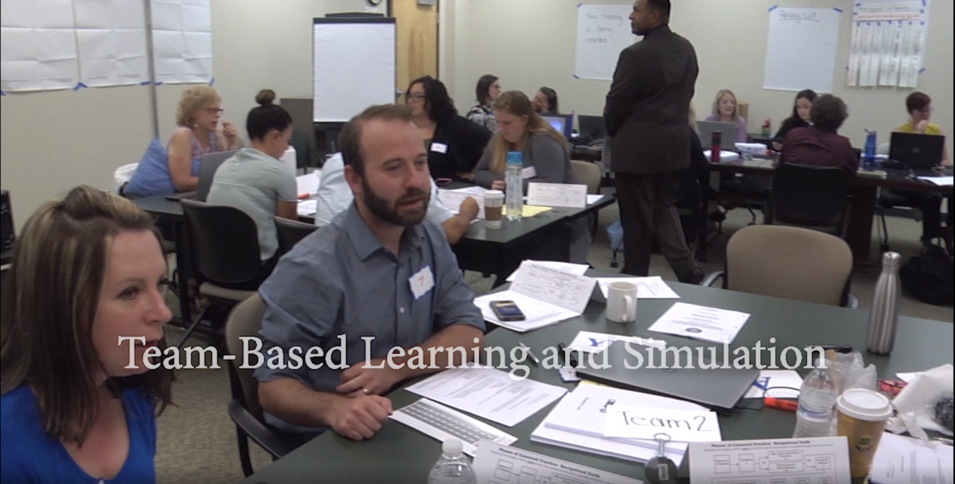
http://www.pacwrc.pitt.edu/Videos/TBLSimVideo2018.mp4

Slide 127
The Mission of Child Welfare
Safety, timely permanence, and well-being for the children in Pennsylvania

Slide 128
Three Questions to Consider During Evaluation
Have you done what you were supposed to do to master those skills? (Implementation Review)
Have you improved through those efforts? (Impact Review)
What lessons have you learned about yourself as you have worked towards improving your skills? (Lessons Learned)

Slide 129
Group Instructions
Refer to the Practice Performance indicators on Handout #11 (At-a-Glance Summary of QSR Indicators) and the indicators on your agency’s performance evaluation.
Crosswalk the two sets of indicators.
Record on flip chart paper indicators that overlap or are related.

Slide 130
Steps in the Performance Evaluation Process
Preparation for the meeting
The meeting
Action planning
Follow-up

Slide 131
Preparation for the Meeting
Explain the purpose of the employee performance review process
Help the employee recognize the importance of continually growing as a professional
Explain the flow of the process
Help the employee connect with the agency’s mission, vision, and values

Slide 132
Preparation for the Meeting (continued)
Ask the employee to come to the review having considered:
where they are currently as a professional
where they would like to see themselves
what they are currently doing or what is currently in place that is helping them to achieve their desired future state
what barriers are in place that keep them from achieving their desired future state
what they need in the future to help them achieve their desired future state

Slide 133
Preparation for the Meeting (continued)
Consider providing the employee with a blank performance evaluation form and ask them to complete it prior to the meeting
Ask the employee to review their job description prior to the meeting

Slide 134
Preparing Yourself for the Meeting
Know and “own” your agency’s mission, vision, and values
Consider how you will get your employee invested in the mission, vision, and values of your agency

Slide 135
Preparing Yourself for the Meeting (continued)
Completing the performance evaluation form:
Collect data
Review notes from the rating period
Review measures to see if employee reached or surpassed goals set for rating period
Focus on behaviors not attitudes
Consider the impact of performance on the agency
Prepare thoroughly for the discussion of goals with your employees

Slide 136
Conducting the Meeting
Revisit any outstanding items/issues
Ask the employee to share
Review your completed version of the evaluation form with the employee and share the goals that you have identified for the employee
Compare notes and solidify goals and next steps

Slide 137
Potential Responses to Identified Goals
Rejection
Acceptance
Commitment
Buy-in

Slide 138
Follow-Up
Base follow-up and monitoring on the established performance standards and performance goals

Slide 139
Remember the Importance of Transfer of Learning Plans!
Complete yours and refer to it often!

