Slide 1
102: Supporting Families in Using Critical Thinking Skills
5-16

Slide 2
Learning Objectives
Define critical thinking and its relationship to outcomes of safety, permanence, and well-being;
Discuss how the parallel process applies to the use of critical thinking with families;
Discuss potential uses of the Enhancing Critical Thinking: A Supervisor’s Guide with families; and
Identify questions to use during interviews with families to stimulate critical thinking.

Slide 3
Agenda
Welcome and Introductions
Defining Critical Thinking
The Enhancing Critical Thinking: A Supervisor’s Guide
The Parallel Process
Supporting Critical Thinking
Action Planning
Summary and Workshop Closure

Slide 4
Critical Thinking Defined
Seeing both sides of an issue, being open to new evidence that disconfirms your ideas, reasoning dispassionately, demanding that claims be backed by evidence, deducing and inferring conclusions based on available facts (and) solving problems.
(Willingham, 2008).

Slide 5
Thinkers’ Thoughts on Thinking
“Thinking is the hardest work there is, which is the probable reason so few engage in it.”
  Henry Ford
“ Many people think they are thinking when they are merely rearranging their prejudices.”
  William James

Slide 6
What gets in the way
of critical thinking and
sound decision
making?
Thinking Errors

Slide 7
Munro’s Findings re: Thinking Errors
Errors not random but predictable
  Not using full range of evidence
  Persisting influence of 1st impression
  Shortcuts made: use facts most vivid, concrete or most recent
  Simplifying reasoning processes involving complex judgments
  Common Errors or Reasoning in Child Protection Work : Eileen Munro: 1999
  From conference workshop presented by Action for Protection at the National Conference on Child Abuse and Neglect, Portland, Oregon, 2007.

Slide 8
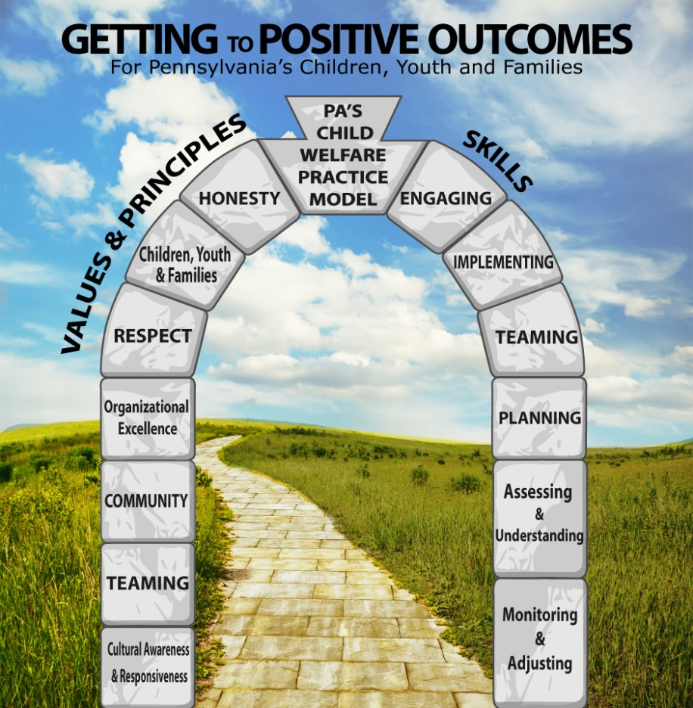
Pennsylvania’s
Child Welfare Practice Model
Outcomes
Values and Principles
Skills
Notes:
Application of Pennsylvania’s Child Welfare Practice Model shapes and improves our ability to engage and team with the children, youth, and families served by our child welfare system.
The model delineates the outcomes, values and principles, and essential skills of quality child welfare practice.
Tech:
Photo from MSOffice Online clip art
Alt.tag: figure standing on a peak supporting a rainbow

Slide 9

Pennsylvania’s
Child Welfare Practice Model: Outcomes
Safety from abuse and neglect
Permanence
Wellbeing
Support through services
Strengthened families
Skilled and responsive child welfare professionals
Notes:
Audio:
Under Pennsylvania’s Child Welfare Practice Model, team members work together to achieve and maintain six key outcomes:
Safety from abuse and neglect.
Enduring and certain permanence and timely achievement of stability, supports and lifelong connections.
Enhancement of the family’s ability to meet their child/youth’s wellbeing, including physical, emotional, behavioral and educational needs.
Support families within their own homes and communities through comprehensive and accessible services that build on strengths and address individual trauma, needs and concerns.
Strengthened families that successfully sustain positive changes that lead to safe, nurturing and healthy environments, and
Skilled and responsive child welfare professionals, who perform with a shared sense of accountability for assuring child-centered, family-focused policy, best practice and positive outcomes.

Slide 10
Activity: Why Should We Care About Critical Thinking?
 | Biological Parent | Resource Parent
Safety
Permanency
Well- being

Slide 11
Tasks of Critical Thinkers
Provide a clear focus on the question or problem
Increase self-awareness and the recognition of cognitive biases
Judge the credibility of sources of information
Analyze and evaluate information
Formulate well-reasoned conclusions and decisions
Communicate clearly and thoughtfully
(University of Pittsburgh, 2011)

Slide 12
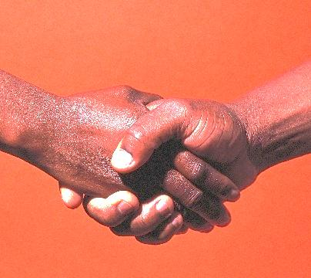
Pennsylvania’s
Child Welfare Practice Model :
Values and Principles
Children, Youth, Families
Community
Honesty
Cultural Awareness
Respect
Teaming
Organizational Excellence
Notes:
Pennsylvania’s Child Welfare Practice Model cites and describes values and principles in seven areas, enumerating and carrying into practice our belief in:
Children, Youth and Families,
Community,
Honesty,
Cultural awareness and responsiveness,
Respect,
Teaming, and
Organizational excellence.
Tech:
Photo from MSOffice Online clip art
Alt.tag: handshake

Slide 13

Pennsylvania’s
Child Welfare Practice Model :
Skills
Engaging
Teaming
Assessing and Understanding
Planning
Implementing
Monitoring and Adjusting
Notes:
The Practice Model also describes six skills essential to achieving our desired outcomes:
Engaging, or establishing and maintaining relationships;
Teaming, or collaborating with others, including the family, in a unified effort throughout all phases of the change process;
Assessing and Understanding, or gathering and sharing information to fully inform the team, and using that information to keep the team’s understanding current and comprehensive;
Planning, or developing strategies and supports to achieve goals;
Implementing, or actively performing roles to produce sustainable results; and
Monitoring and Adjusting, or continuously evaluating effectiveness and modifying until goals are achieved
Tech:
Photo from MSOffice Online clip art
Alt.tag: team members talking together

Slide 14
Guiding Critical Thinking
Thinking is not driven by answers, but by questions.
  The Critical Thinking Community (2013)

Slide 15
Child/Youth and Family Status Indicators
Safety: Exposure to Threats of Harm
Safety: Risk to Self/Others
Stability
Living Arrangement
Permanency
Physical Health
Emotional Well-Being
Early Learning and Development
Academic Status
Pathway to Independence
Parent or Caregiver Functioning

Slide 16
Practice Performance Indicators
Engagement Efforts
Role & Voice
Teaming
Cultural Awareness & Responsiveness
Assessment & Understanding
Long-Term View
Child/Youth & Family Planning Process
Planning for Transitions & Life Adjustments
Efforts to Timely Permanence
Intervention Adequacy & Resource Availability
Maintaining Family Relationships
Tracking & Adjusting

Slide 17
Supervisor’s Guide: Small Group Discussion
What experiences have you had with your supervisors using the Supervisor’s Guide during supervision?
What are the various ways your supervisors are using it?
Has it changed the way you prepare for supervision? If so, how?
Has it changed the way you work with children, youth, and families? If so, how?

Slide 18
Ways a Supervisor Can Use the Enhancing Critical Thinking: A Supervisor’s Guide
Worker need
Department/unit focus area
Supervisory skill development

Slide 19
“Quick Tool”
Follows the same type of sequencing that the Supervisor Guide follows:
Description of Family/Current Status
Perspective of the Team
Worker Analysis
Evaluation
Decisions and Next Steps

Slide 20
According to Shulman…
“…there are parallels between the dynamics of supervision and any other helping relationship. Therefore, the skills that are important in direct practices with clients or patients are also important to the supervisory relationship.”
(Shulman, 2010)

Slide 21
The Parallel Process in Child Welfare
Administrators and Managers
Supervisors
Caseworkers
Caregivers

Slide 22
Small Group Discussion: Parallel Process
What does this all mean to you as you work with families?
How can a caseworker use the Supervisor’s Guide?
Administrators and Manager
Supervisors
Caseworkers
Caregivers

Slide 23
Practice Performance Indicator Activity
Review the sections of Handouts #6 and Handout #7 pertaining to your assigned indicator(s) and discuss.
Develop questions for your assigned indicator that you could ask family members to support the use of critical thinking skills and to help you assess how well the family demonstrates PA Practice Model values and skills.
Be prepared to join other teams in a group discussion.

Slide 24
Deciding Which Questions to Ask: Activity Instructions
Identify at least eight questions for your situation that you could ask the individual to support the use of critical thinking skills and to help you assess how well he/she has implemented the PA Practice Model.
Write questions on flip chart.

Slide 25

Walk Around Instructions: For each scenario…
Read the scenario, discuss, and practice each set of questions.
Put a check mark √ next to those questions that worked well in your role play.
Put a question mark ? next to those that didn’t work or seemed awkward.
Add to the flip chart additional questions that you feel are critical to the situation.

Slide 26
Questions to Consider
On a scale of 1 to 10, with 1 you have very little commitment to using these identified questions with caregivers and 10 being you are strongly committed to using them with caregivers – how would you rate yourself?
What would it take to move up the scale one point?
How will you monitor that caregivers are critically thinking through challenges they face regarding their children’s care?

Slide 27
Action Planning
Identify at least three questions you will use during your next family interview.

Slide 28
You Must Have Questions!

Slide 29
Learning Objectives
Define critical thinking and its relationship to outcomes of safety, permanence, and well-being;
Discuss how the parallel process applies to the use of critical thinking with families;
Discuss potential uses of the Enhancing Critical Thinking: A Supervisor’s Guide with families; and
Identify questions to use during interviews with families to stimulate critical thinking.

