Slide 1
Critical Thinking: Strategies for Understanding Older Youth in Care

Slide 2
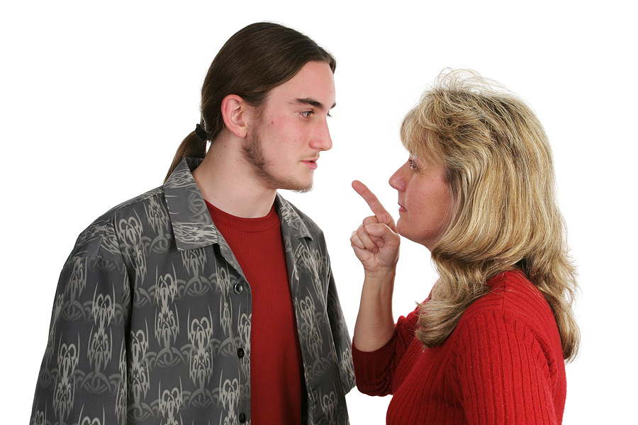
1

Slide 3
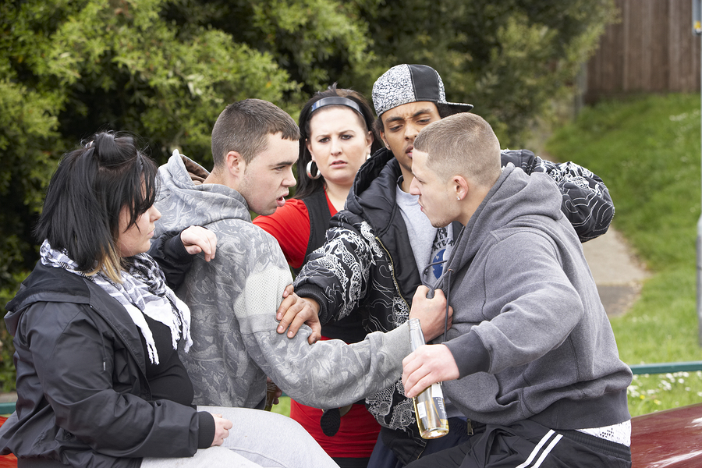
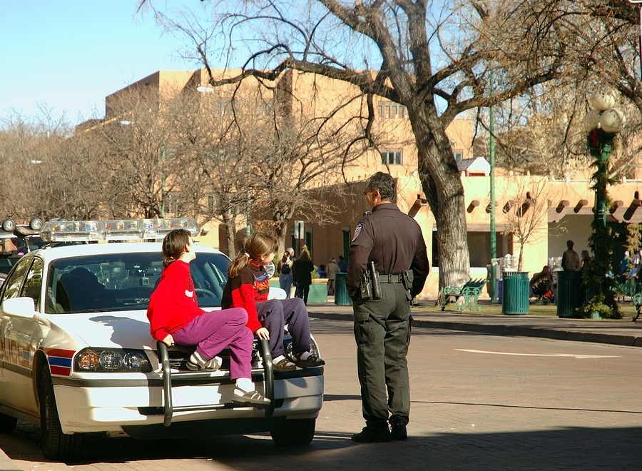
2

Slide 4

3

Slide 5

4

Slide 6
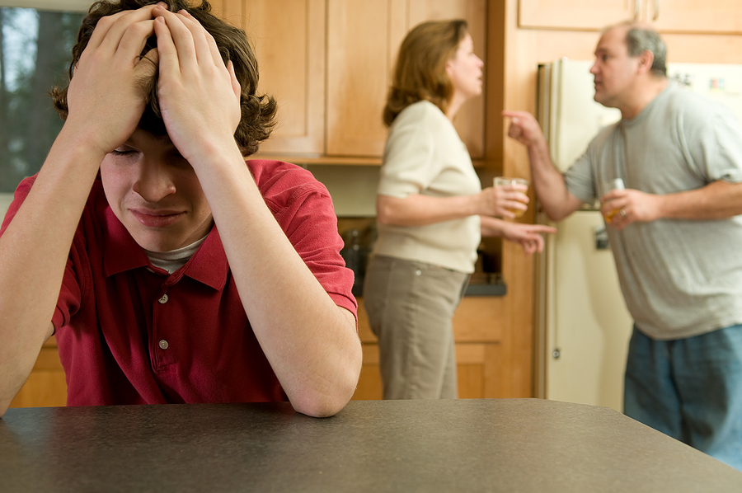
5

Slide 7
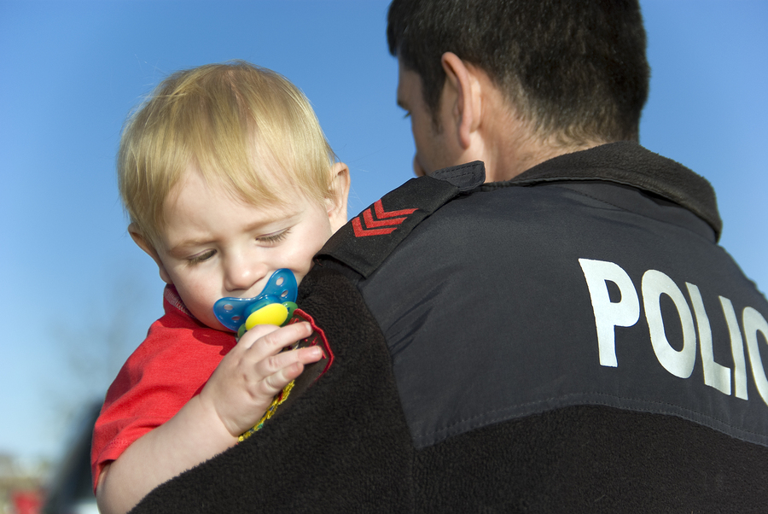

6

Slide 8
Influences
Past experience
Current Events
Gut/Instincts
Values
Prior knowledge
Sense of justice/rightness
Other

Slide 9
Critical Thinking is . . .

Slide 10
Small Group Instructions
Write a few sentences to answer each of the questions below about your assigned “case”:
  Very briefly, describe what you thought was happening when you first looked at this picture.
  What assumptions might a child welfare professional make when confronted with this type of situation?
  What else might be happening?
  Use critical thinking to develop 3-4 questions to ask the youth involved, to find out what you need to know about the situation to be able to assist and support.

Slide 11
Wrap up and Evaluations

