Slide 1
302: Building and Sustaining Father Engagement

Slide 2
"It is much easier to become a father than to be one."
-Kent Nerburn

Slide 3
Agenda – Day 1
Welcome and Introductions
Values, Roles, and Responsibilities
Protocol for Engagement and the Father Engagement Bench Card
Establishing Paternity and Locating Fathers
Review and Day 1 Wrap Up

Slide 4
Agenda – Day 2
Welcome Back and Review of Day 1
The Process of Engaging Men
Overcoming Barriers and Managing Resistance
Identifying a Father’s Strengths and Needs
Identifying Formal and Informal Support Services
Content Review, Wrap Up and Evaluations

Slide 5
Learning Objectives
Recognize the need for and importance of locating and engaging fathers;
Recognize the impact of personal values on interactions with fathers;
Describe established protocols for father engagement and the father engagement bench card;
Discuss the impact a father can have on a child’s healthy development; and
Identify various methods of father and paternal family engagement.

Slide 6
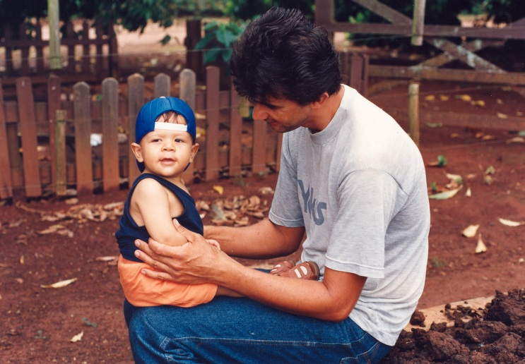
Values and Bias
Values
“The moral principles and beliefs or accepted standards of a person or social group.”
Bias
“An inclination of temperament or outlook; especially : a personal and sometimes unreasoned judgment”

Slide 7
Father’s Impact on Child Well-Being
Mother/Father Relationships
Cognitive Ability and Educational Success
Psychological Well-being and Social Behavior

Slide 8
Protocol for Father Engagement Activity
Individually
review assigned protocol
Small group
prepare to teach your colleagues about your assigned best practice protocol
Triads
teach and discuss

Slide 9
Review and Prepare
Review the protocol for your assigned role (i.e., agency, court, or attorney) (5 minutes)
As a small group, prepare to teach your colleagues about your assigned best practice protocol for each of the following areas
Case Planning (Preparation time: 15 minutes)
Delivery of Services (Preparation time: 15 minutes)
Court Process (Preparation time: 15 minutes)

Slide 10
Teach and Discuss
Teach the other members about ONE area of best practice protocol at a time and discuss challenges/barriers to as well as solutions for implementing the protocol.
Case Planning (5 minutes per participant/role)
Delivery of Services (5 minutes per participant/role)
Court Process (5 minutes per participant/role)

Slide 11
Activity – Father Engagement Scenarios
How would you engage the father in case planning as a…
Child welfare professional?
Court?
Attorney?
How would you engage the father in the delivery of services as a…
Child welfare professional?
Court?
Attorney?
How would you engage the father in the court process as a…
Child welfare professional?
Court?
Attorney?

Slide 12
Video Clip – Kindergarten Cop©

Slide 13
Agenda – Day 2
Welcome Back and Review of Day 1
The Process of Engaging Men
Overcoming Barriers and Managing Resistance
Identifying a Father’s Strengths and Needs
Identifying Formal and Informal Support Services
Content Review, Wrap Up, and Evaluations

Slide 14
Agenda – Day 1
Welcome and Introductions
Values, Roles, and Responsibilities
Protocol for Engagement and the Father Engagement Bench Card
Establishing Paternity and Locating Fathers
Review and Day 1 Wrap Up

Slide 15
A Tale of Two Brains – Mark Gungor

Slide 16
Female and Male Communication Styles

Slide 17
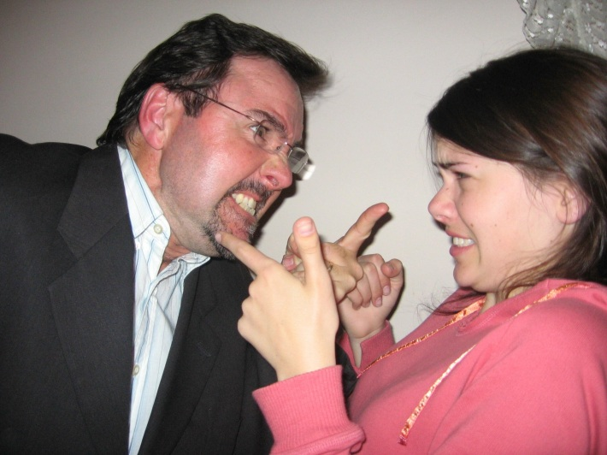
Types of Resistance
Arguing;
Interrupting;
Denying; and
Ignoring.

Slide 18
Overcoming Resistance Activity
Identify most common response
Using the Engagement Toolbox handout, identify
two Interactional Helping Skills;
one strength-based, solution-focused question; and
one “other technique” (located on the last page)
that you believe will be helpful in overcoming your assigned type of resistance (i.e., arguing, interruption, denial, or ignoring).

Slide 19
Effective Father Programs
Prevent
Prepare
Establish
Involve
Support

Slide 20
Resources and Support Services
Community Resources
Types of Services:
Employment Services
Medical, Mental Health, Substance Abuse Treatment Programs
Protection from Abuse Orders
Domestic Relations Orders
Legal Support
County Assistance
Father’s Rights
Education Programs

Slide 21
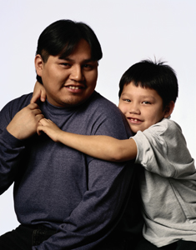
Questions About Resources
What kinds of services/agencies might need to be recommended for fathers trying to engage more actively with their children?
What resources are available in your area?

